Slide 10
Basic Program on Java
public class MyFirstClass {
public static void main(String[] args) {
System.out.println("Hello world");
}
}

Slide 17
Program code of datatype
package Second;
public class Second {
public static void main(String[] args) {
int x;
x=3;
double y = 5.5;
System.out.println("x is "+x);
System.out.println("y is "+y);
}
}

Slide 18
Operators & Operator Precedence

Slide 20
Code Snippet for operators
public class Third {
public static void main(String[] args) {
int a = 5;
int b = 3;
int c = 4;
int sum = a + b * c;
System.out.println("sum is "+sum);
}
}

Slide 21
What is a Class ?
It is a template or blueprint from which objects are created.
It is a logical entity. It can’t be physical.
A class in Java can contain:
Fields (variables)
methods
constructors
blocks
nested class and interface
What is n Object ?
An entity that has state and behavior is known as an object.
An object has three characteristics:
state: represents data (value) of an object.
behavior: represents the behavior (functionality) of an object such as deposit, withdraw etc.
identity: Object identity is typically implemented via a unique ID.
The value of the ID is not visible to the external user. But, it is used internally by the JVM to identify each object uniquely.
Relation Between Class and Object –
Object is an instance of a class.
Class is a template or blueprint from which objects are created.
So object is the instance(result) of a class.
In another way, we can say that objects are variables of type class

Slide 22
Some Important Concepts that come along with Classes and Objects are –
Instance variables
Methods
new keyword
Instance variable in Java
A variable which is created inside the class but outside the method, is known as instance variable. Instance variable doesn’t get memory at compile time. It gets memory at run time when object(instance) is created. That is why, it is known as instance variable.
Method in Java
In java, a method is like function i.e. used to expose behavior of an object.
Advantage of Method
Code Reusability
Code Optimization
new keyword in Java
The new keyword is used to allocate memory at run time. All objects get memory in Heap memory area.

Slide 23
package mystudentexample;
class Student{
int id; // instance variables
String name; // instance variables
}
public class MyStudentExample {
public static void main(String[] args) {
Student object1 = new Student();
Student obj2;
obj2 = new Student();
obj2.id = 2;
obj2.name = "Simple Snippets";
object1.id = 1;
object1.name = “Srikanth";
System.out.println(object1.id);
System.out.println(object1.name);
System.out.println(obj2.id);
System.out.println(obj2.name);
}
}

Slide 24
Java Methods
Types of Methods
Standard Library Methods
User-defined Methods
Standard Library Methods
public class Numbers {
public static void main(String[] args) {
System.out.print("Hello World");
}
}
User-defined Methods
public class FunctionExample {
public int max(int x, int y)
{
if(x>y){
return x;
}
else {
return y;
}
}
public static void main(String[] args) {
// TODO code application logic here
FunctionExample obj = new FunctionExample();
int num = obj.max(5, 6); // FUNCTION CALL
System.out.println("Max value is: "+num);
}
}

Slide 25
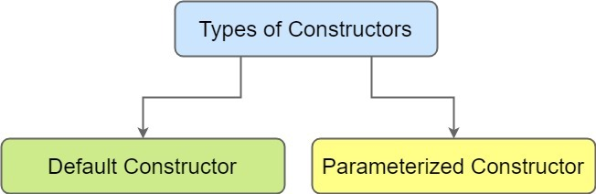
Java Constructors Explained
A constructor is a special method in Java. It is called when an instance of object is created and memory is allocated for the object. It is called constructor because it constructs the values at the time of object creation.

Slide 26
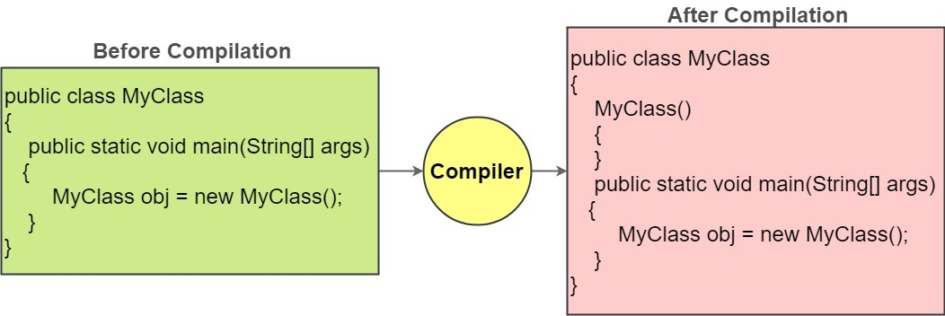
Default Constructor
A constructor that has no parameter is known as default constructor. If we don’t define a constructor in a class, then compiler creates default constructor(with no arguments) for the class.

Slide 27
Default constructor example
public class MyClass {
int number;
public MyClass() {
System.out.println("Constructor Called");
number=5;
}
public static void main(String[] args) {
MyClass obj = new MyClass(); // Constructor Called
System.out.println("Number value is: "+obj.number);
}
}

Slide 28
Parameterized Constructor
public class MyClass {
int number;
public MyClass(int x) {
System.out.println("Parameterized Constructor Called");
number=x;
}
public static void main(String[] args) {
MyClass obj = new MyClass(4); // Parameterized Constructor Called
System.out.println("Number value is: "+obj.number);
}
}

Slide 29
Constructor Overloading
public class MyClass {
int num1;
double num2;
//Default Constructor
public MyClass()
{
System.out.println("Default Constructor Called");
num1=1;
num2=1.5;
}
//Parameterized Constructor 1
public MyClass(int x) {
System.out.println("Parameterized Constructor 1 Called");
num1=x;
}
//Parameterized Constructor 2
public MyClass(int x, double z) {
System.out.println("Parameterized Constructor 2 Called");
num1=x;
num2=z;
}
void displayData()
{
System.out.println("Num1: "+num1+"\nNum2: "+num2);
}
public static void main(String[] args) {
MyClass obj1 = new MyClass(); // Default Constructor Called
obj1.displayData();
MyClass obj2 = new MyClass(5); // Parameterized Constructor 1 Called
obj2.displayData();
MyClass obj3 = new MyClass(5,5.5); // Parameterized Constructor 2 Called
obj3.displayData();
}
}

Slide 30
Simple Java Program for Practice
Swap of two numbers
Public class swap{
public static void main(String[] args)
{
int first = 5, second = 10;
System.out.println("--Before swap--");
System.out.println("First number = " + first);
System.out.println("Second number = " + second);
// Value of first is assigned to temporary
int temporary = first;
// Value of second is assigned to first
first = second;
// Value of temporary (which contains the initial value of first) is assigned to second
second = temporary;
System.out.println("--After swap--");
System.out.println("First number = " + first);
System.out.println("Second number = " + second);
}}

Slide 31
2. Number is positive or negative
public static void main(String[] args)
{
double number = 12;
if (number < 0.0)
{
System.out.println(number + " is a negative
number.");
}
else if ( number > 0.0)
{
System.out.println(number + " is a positive
number.");
}
else
{
System.out.println(number + " is 0.");
}
}

Slide 32
Recursion in Java
Recursion in Java is a process in which a method calls itself continuously. Using recursive algorithm, certain problems can be solved quite easily.
Examples of such problems are Towers of Hanoi (TOH), Inorder/Preorder/Postorder Tree Traversals, DFS of Graph, etc. A method in java that calls itself is called recursive method.
public class FactorialExample {
static int fact(int n)
{
if(n!=1)
{
return n*(fact(n-1));
}
else
{
return 1;
}
}
public static void main(String[] args)
{
System.out.println("Factorial of 4 is: "+fact(4));
}
}

Slide 33
Method Overloading
Method overloading in Java is a feature which makes it possible to use the same method name to
perform different tasks.
public static void main(String[] args)
{
int a=5;
double b = 7.5;
float c = 4.5f;
double result;
Methodoverloading obj = new Methodoverloading();
result = obj.add(a, b);
System.out.println("Addtion is: "+result);
result = obj.add(b, a);
System.out.println("Addtion is: "+result);
result = obj.add(b,a,c);
System.out.println("Addtion is: "+result);
}
}
Output:
Addition is: 12.5
Addition is: 12.5
Addition is: 17.0
public class Methodoverloading
{
double add(int x, double y)
{
return(x+y);
}
double add(double x, int y)
{
return(x+y);
}
double add(double x, int y, float z)
{
return(x+y+z);
}

Slide 34
static keyword
The static keyword in java is used primarily for memory management.
Static keyword can be used with class, variable, method and blocks.
The static keyword belongs to the class than instance of the class i.e if you make a member static, you can access it without object.
The static can be:
variable (also known as class variable)
method (also known as class method)
block
nested class

Slide 35
1. static Variable
public class Cube
{
int side;
static int objectCount=0;
Cube()
{
objectCount++;
}
Cube(int x)
{
side=x;
objectCount++;
}
public static void main(String[] args)
{
Cube c1=new Cube();
Cube c2=new Cube(5);
Cube c3=new Cube(8);
Cube c4=new Cube(10);
Cube c5=new Cube(11);
System.out.println("Number of Cube Objects: "+objectCount);
}
}
Output: 05

Slide 36
2. static Method
Main Use: Object creation isn’t required, we can
directly access static method from main function
public class Cube
{
static int calculateCube(int side)
{
return (side*side*side);
}
public static void main(String[] args)
{
//System.out.println("Cube value of 5 is: "+calculateCube(5));
System.out.println("Cube value of 5 is: "+Cube.calculateCube(5));
}
}
NOTE:
Why java main method is static?
The main reason why java main() method is made static is because object is not required to call static method.
If it were non-static method, jvm create object first then call main() method that will lead the problem of extra memory allocation.

Slide 37
3. static Blocks in Java
So in general static block –
Is used to initialize the static data member.
It is executed before main method at the time of classloading.
public class Cube {
static
{
System.out.println("static block is invoked");
}
static int calculateCube(int side)
{
return (side*side*side);
}
public static void main(String[] args) {
//System.out.println("Cube value of 5 is: "+calculateCube(5));
System.out.println("Cube value of 5 is: "+Cube.calculateCube(5));
}
}
Output:
static block is invoked
Cube value of 5 is: 125

Slide 38
4. static class
static class in Java
A class can be made static only if it is a nested class.
1. Nested static class doesn’t need reference of Outer class
2. A static class cannot access non-static members of the Outer class
Syntax
class One
{
class Two
{
disp(){
}
}
}
psvm()
{
One obj1 = new One();
obj1.disp();
One.Two obj2 = new One.Two();
obj2.disp();
}
}

Slide 39
CODE: static Class in Java
class JavaExample
{
private static String str = "TNS Java Sessions";
static class MyNestedClass
{
public void disp()
{
System.out.println(str);
}
}
public static void main(String args[])
{
JavaExample.MyNestedClass obj = new JavaExample.MyNestedClass();
obj.disp();
}

Slide 40
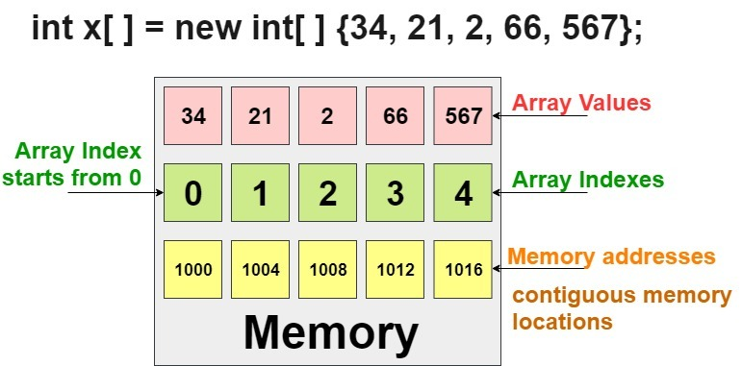
Arrays in Java with Program Examples
Arrays in Java are a group of like-typed variables that are referred to by a common name.
Array is a collection of similar type of elements that have contiguous memory location.
Arrays in Java are Objects.
In Java all arrays are dynamically allocated.(discussed below)
Java array can be also be used as a static field, a local variable or a method parameter.
The size of an array must be specified by an int value and not long or short.
In case of primitives data types, the actual values are stored in contiguous memory locations.
In case of objects of a class, the actual objects are stored in heap segment.

Slide 41
Types of Array in java
There are two types of array.
Single Dimensional Array
Multidimensional Array
Single Dimensional Arrays
Creating, Initializing, and Accessing an Array
The general form of a one-dimensional array declaration is
type var-name[];
OR
type[] var-name;
Instantiating an Array in Java
int intArray[]; //declaring array
intArray = new int[20]; // allocating memory to array
int[] intArray = new int[20]; // combining both statements in one

Slide 42
class Testarray {
public static void main(String args[]) {
int a[] = new int[5]; //declaration and instantiation
a[0] = 10; //initialization
a[1] = 20;
a[2] = 70;
a[3] = 40;
a[4] = 50;
//printing array
for (int i = 0; i < a.length; i++) //length is the property of array
System.out.println(a[i]);
}
}

Slide 43
Arrays of Objects
An array of objects is created just like an array of primitive type data items in the following way.
class Student
{
public int roll_no;
public String name;
Student(int roll_no, String name)
{
this.roll_no = roll_no;
this.name = name;
}
}
// Elements of array are objects of a class Student.
public class GFG
{
public static void main (String[] args)
{
// declares an Array of integers.
Student[] arr;
// allocating memory for 5 objects of type Student.
arr = new Student[5];
// initialize the first elements of the array
arr[0] = new Student(1,"aman");
// initialize the second elements of the array
arr[1] = new Student(2,"vaibhav");
// so on...
arr[2] = new Student(3,"shikar");
arr[3] = new Student(4,"dharmesh");
arr[4] = new Student(5,"mohit");
// accessing the elements of the specified array
for (int i = 0; i < arr.length; i++)
System.out.println("Element at " + i + " : " +
arr[i].roll_no +" "+ arr[i].name);
}
}

Slide 44
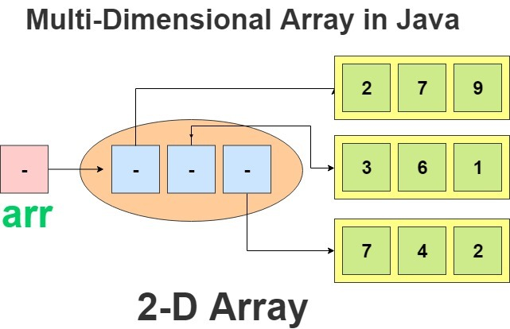
Java Multi Dimensional Arrays
int[][] intArray = new int[10][20]; //a 2D array or matrix
int[][][] intArray = new int[10][20][10]; //a 3D array
2-D Array in Java Example Program
class multiDimensional
{
public static void main(String args[])
{
int arr[][] = { {2,7,9},{3,6,1},{7,4,2} };
for (int i=0; i< 3 ; i++)
{
for (int j=0; j < 3 ; j++)
System.out.print(arr[i][j] + " ");
System.out.println();
}
}
}

Slide 45
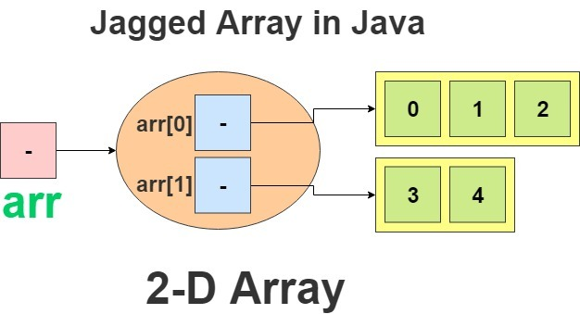
Jagged array in java is array of arrays such that member arrays can be of different sizes, i.e., we can create a 2-D arrays but with variable number of columns in each row. These type of arrays are also known as Jagged arrays.

Slide 46
// Program to demonstrate 2-D jagged array in Java
class Main
{
public static void main(String[] args)
{
// Declaring 2-D array with 2 rows
int arr[][] = new int[2][];
// Making the above array Jagged
// First row has 3 columns
arr[0] = new int[3];
// Second row has 2 columns
arr[1] = new int[2];
// Initializing array
int count = 0;
for (int i=0; i<arr.length; i++)
for(int j=0; j<arr[i].length; j++)
arr[i][j] = count++;
// Displaying the values of 2D Jagged array
System.out.println("Contents of 2D Jagged Array");
for (int i=0; i<arr.length; i++)
{
for (int j=0; j<arr[i].length; j++)
System.out.print(arr[i][j] + " ");
System.out.println();
}
}
}
Contents of 2D Jagged Array
0 1 2
3 4

Slide 47
Java Single Inheritance Program Example –
class Animal
{
void eat()
{
System.out.println("eating...");
}
}
class Dog extends Animal
{
void bark()
{
System.out.println("barking...");
}
}
class TestInheritance
{
public static void main(String args[])
{
Dog d=new Dog();
d.bark();
d.eat();
}
}

Slide 48
Single Level Inheritence – Program 2
Class A
{
public void methodA()
{
System.out.println("Base class method");
}
}
Class B extends A
{
public void methodB()
{
System.out.println("Child class method");
}
public static void main(String args[])
{
B obj = new B();
obj.methodA(); //calling super class method
obj.methodB(); //calling local method
}
}

Slide 49
Java Multilevel Inheritance Program Example –
class Animal {
void eat() {
System.out.println("eating...");
}
}
class Dog extends Animal {
void bark() {
System.out.println("barking...");
}
}
class BabyDog extends Dog {
void weep() {
System.out.println("weeping...");
}
}
class TestInheritance2 {
public static void main(String args[]) {
BabyDog d = new BabyDog();
d.weep();
d.bark();
d.eat();
}
}

Slide 50
Multilevel Inheritence – Example2
Class SuperClass
{
public void methodA()
{
System.out.println("SuperClass");
}
}
Class SubClass1 extends SuperClass
{
public void methodB()
{
System.out.println("SubClass1 ");
}
}
Class SubClass2 extends SubClass1
{
public void methodC()
{
System.out.println("SubClass2");
}
public static void main(String args[])
{
SubClass2 obj = new SubClass2();
SubClass2.methodA(); //calling super class method
SubClass2.methodB(); //calling subclass 1 method
SubClass2.methodC(); //calling own method
}
}

Slide 51
Java Hierarchial Inheritance Program Example –
class Animal {
void eat() {
System.out.println("eating...");
}
}
class Dog extends Animal {
void bark() {
System.out.println("barking...");
}
}
class Cat extends Animal {
void meow() {
System.out.println("meowing...");
}
}
class TestInheritance3 {
public static void main(String args[]) {
Cat c = new Cat();
c.meow();
c.eat();
//c.bark();//C.T.Error
}
}

Slide 52
Java Hierarchial Inheritance Program Example –2
Class A
{
public void methodA()
{
System.out.println("Super class method");
}
}
Class B extends A
{
public void methodB()
{
System.out.println("Sub class Method B");
}
}
Class C extends A
{
public void methodC()
{
System.out.println("Sub class Method C");
}
public static void main(String args[])
{
A obj1 = new A();
B obj2 = new B();
C obj3 = new C();
obj1.methodA(); //calling super class method
obj2.methodA(); //calling A method from subclass object
obj3.methodA(); //calling A method from subclass object
}
}

Slide 53
Why multiple inheritance is not supported in java?
To reduce the complexity and simplify the language, multiple inheritance is not supported in java.
Consider a scenario where A, B and C are three classes. The C class inherits A and B classes. If A and B classes have same method and you call it from child class object, there will be ambiguity to call method of A or B class.
In C++ we have virtual keyword to tackle this ambiguity however, in Java Multiple Inheritance is possible only via Interfaces.

Slide 54
Java Even Odd Program Code Example –
class CheckEvenOdd
{
public static void main(String args[])
{
int num;
System.out.println("Enter an Integer number:");
//The input provided by user is stored in num
Scanner input = new Scanner(System.in);
num = input.nextInt();
/* If number is divisible by 2 then it's an even number
* else odd number*/
if ( num % 2 == 0 )
System.out.println("Entered number is even");
else
System.out.println("Entered number is odd");
}
}

Slide 55
Java Largest of Three Numbers Program Code Example –
import java.util.Scanner;
class LargestOfThreeNumbers
{
public static void main(String args[])
{
int x, y, z;
System.out.println("Enter three integers ");
Scanner in = new Scanner(System.in);
x = in.nextInt();
y = in.nextInt();
z = in.nextInt();
if ( x > y && x > z )
System.out.println("First number is largest.");
else if ( y > x && y > z )
System.out.println("Second number is largest.");
else if ( z > x && z > y )
System.out.println("Third number is largest.");
else
System.out.println("Entered numbers are not distinct.");
}
}

Slide 56
Swapping of 2 Variables using 3rd Variable in C++
#include <iostream>
using namespace std;
int main() {
int a,b,c;
cout<<"Enter value of a: ";
cin>>a;
cout<<"Enter value of b: ";
cin>>b;
cout<<"Before Swapping: a: "<<a<<" b: "<<b<<endl;
// start: swapping logic
c=a;
a=b;
b=c;
// end: swapping logic
cout<<"After Swapping: a: "<<a<<" b: "<<b<<endl;
return 0;
}

Slide 57
Swapping of 2 Variables Without using 3rd Variable in C++
#include <iostream>
using namespace std;
int main() {
int a,b;
cout<<"Enter value of a: ";
cin>>a;
cout<<"Enter value of b: ";
cin>>b;
a=a+b;
b=a-b;
a=a-b;
cout<<"After swap a: "<<a<<" b: "<<b;
return 0;
}

Slide 58
Java program to check LEAP year
public class JavaApplication4 {
public static void main(String[] args) {
int year = 2020;
if(year%400==0)
{
System.out.println("Leap Year");
}
else if(year%4==0 && year%100!=0)
{
System.out.println("Leap Year");
}
else
{
System.out.println("Not a Leap Year");
}
}
}

Slide 59
Java program to Find Factorial of a Number
public class JavaApplication4 {
public static void main(String[] args) {
int num = 4;
int factorial =1;
for(int i = num; i>0; i--)
{
factorial = factorial *i;
}
System.out.println("Factorial is: "+factorial);
}
}

Slide 60
Java program to Find if a Number is PALINDROME or not –
package javaapplication4;
public class JavaApplication4 {
public static void main(String[] args) {
int num=121;
int temp=num;
int rev = 0;
while(num>0)
{
rev = rev*10;
rev = rev + num%10;
num = num/10;
}
if(temp == rev)
{
System.out.println("Palindrome");
}
else
{
System.out.println("Not Palindrome");
}
}
}

Slide 61
Java Program to Print FIBONACCI Series using FOR LOOP
// 0 + 1 + 1 + 2 + 3 + 5 + 8 +
package javaapplication4;
public class JavaApplication4 {
public static void main(String[] args) {
int a = 0;
int b = 1;
int c;
for(int i = 0; i<5 ; i++)
{
System.out.print(a+" ");
c = a+b;
a=b;
b=c;
}
}
}

Slide 62
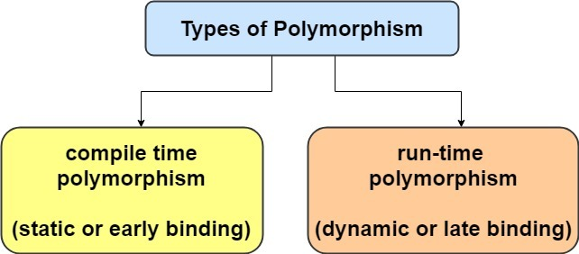
Polymorphism in Java – Method Overloading | Method Overriding
Polymorphism is derived from 2 greek words: poly and morphs. The word “poly” means many and “morphs” means forms. So Polymorphism means the ability to take many forms.
Polymorphism is a concept by which we can perform a single task in different ways.
Compile Time Polymorphism – Method Overloading
Run Time Polymorophism – Method Overriding

Slide 63
Run Time Polymorphism
Runtime polymorphism or Dynamic Method Dispatch is a process in which a call to an overridden method is resolved at runtime rather than compile-time.
In this process, an overridden method is called through the reference variable of a superclass. Thus this happens only when Inheritance is implemented.
The method to be called is based on the object being referred to by the reference variable.
Some Rules to follow in Method Overriding –
Overriding and Access-Modifiers : The access modifier for an overriding method can allow more, but not less, access than the overridden method. For example, a protected instance method in the super-class can be made public, but not private, in the subclass.
Final methods can not be overridden.
Static methods can not be overridden(Method Overriding vs Method Hiding).
Private methods can not be overridden.
The overriding method must have same return type (or subtype)
Invoking overridden method from sub-class : We can call parent class method in overriding method using super keyword.

Slide 64
// A Simple Java program to demonstrate
// method overriding in java
// Base Class
class Parent
{
void show() { System.out.println("Parent's show()"); }
}
// Inherited class
class Child extends Parent
{
// This method overrides show() of Parent
@Override
void show() { System.out.println("Child's show()"); }
}
// Driver class
class Main
{
public static void main(String[] args)
{
// If a Parent type reference refers
// to a Parent object, then Parent's
// show is called
Parent obj1 = new Parent();
obj1.show();
// If a Parent type reference refers
// to a Child object Child's show()
// is called. This is called RUN TIME
// POLYMORPHISM.
Parent obj2 = new Child();
obj2.show();
}
}

Slide 65
Packages in Java
Package in java as the name suggests is a pack(group) of classes, interfaces and other packages.
Packages are used in Java in order to prevent naming conflicts, to control access, to make searching/locating and usage of classes, interfaces, enumerations and annotations easier, etc.
Packages are used for:
Preventing naming conflicts. For example there can be two classes with name Teacher in two packages, college.staff.icse.Teacher and college.staff.cbse.Teacher
Making searching/locating and usage of classes, interfaces, enumerations and annotations easier.
Providing access control: protected and default have package level access control. A protected member is accessible by classes in the same package and its subclasses. A default member (without any access specifier) is accessible by classes in the same package only.
Packages can be considered as data encapsulation (or data-hiding).

Slide 66
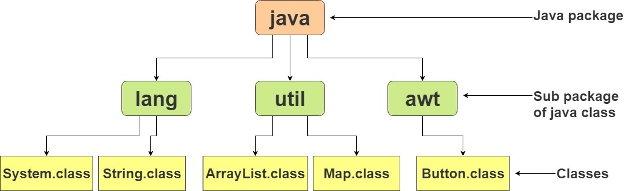
Package in java can be categorized in two form,
built-in package
user-defined package.

Slide 67
Simple example of java package
The package keyword is used to create a package in java.
//save as Simple.java
package mypack;
public class Simple{
public static void main(String args[]){
System.out.println("Welcome to package");
}
}
How to access package from another package?
import package.*;
import package.classname;

Slide 68
1) Using packagename.*
If you use package.* then all the classes and interfaces of this package will be accessible but not subpackages.
The import keyword is used to make the classes and interface of another package accessible to the current package.
//save by B.java
package mypack;
import pack.*;
class B{
public static void main(String args[]){
A obj = new A();
obj.msg();
}
}

Slide 69
2) Using packagename.classname
If you import package.classname then only declared class of this package will be accessible.
Example of package by import package.classname
package pack;
public class A{
public void msg(){System.out.println("Hello");}
}
//save by B.java
package mypack;
import pack.A;
class B{
public static void main(String args[]){
A obj = new A();
obj.msg();
}
}

Slide 70
Packages Example
Step1 : package pack;
public class A{
public void msg(){System.out.println("Hello");}
}
Step 2: import pack.*;
import Subpackage.*;
class B{
public static void main(String args[]){
A obj = new A();
C obj1 = new C();
D obj2 = new D();
obj.msg();
obj1.msg();
obj2.msg();
}
}
Step 1.1 package pack;
public class C {
public void msg()
{
System.out.println("Hello C");
}
}
Step 1.3 package Subpackage;
public class D {
public void msg(){System.out.println("Hello D");}
}

Slide 71
Access Modifiers in Java
Access modifiers in java specify the scope of a class, constructor , variable , method or data
member. There are four types of access modifiers available in java:
Private - The private access modifier is accessible only within class
Default – No keyword required - accessible only within package.
Protected - is accessible within package and outside the package but through inheritance only
Public - The public access modifier is accessible everywhere

Slide 72
Private Access Modifier
The private access modifier is accessible only within class. The private access modifier is
specified using the keyword private.
The methods or data members declared as private are accessible only within the
class in which they are declared.
Any other class of same package will not be able to access these members.
Classes or interface can not be declared as private.
package p1;
class A
{
private void display()
{
System.out.println("TNS Sessions");
}
}
class B
{
public static void main(String args[])
{
A obj = new A();
//trying to access private method of another class
obj.display();
}
}
Output
error: display() has private access in A
obj.display();

Slide 73
Default Access Modifier
If you don’t use any modifier, it is treated as default by default. The default modifier is accessible
only within package.
The data members, class or methods which are not declared using any access modifiers
i.e. having default access modifier are accessible only within the same package.
package p1;
//Class MyClass1 is having Default access modifier
class MyClass1
{
void display()
{
System.out.println("Hello World!");
}
}
package p2;
import p1.*;
//This class is having default access modifier
class MyClass2
{
public static void main(String args[])
{
//accessing class MyClass1 from package p1
MyClass1 obj = new MyClass1();
obj.display();
}
}
Output
Compile time error

Slide 74
Protected Access Modifier
The protected access modifier is specified using the keyword protected.
The protected access modifier is accessible within package and outside the package but through inheritance only.
The protected access modifier can be applied on the data member, method and constructor.
It can’t be applied on the class.
package p1;
public class A
{
protected void display()
{
System.out.println("TNS Sessions");
}
}
package p2;
import p1.*;
public class B extends A
{
public static void main(String[] args)
{
B obj = new B();
obj.display();
}
}
Output: TNS Sessions

Slide 75
Public Access Modifier
The public access modifier is specified using the keyword public.
The public access modifier is accessible everywhere. It has the widest scope among all other modifiers.
Classes, methods or data members which are declared as public are accessible from every where in the program. There is no restriction on the scope of a public data members.
package p1;
public class A
{
public void display()
{
System.out.println("TNS Sessions");
}
}
package p2;
import p1.*;
class B
{
public static void main(String[] args)
{
A obj = new A();
obj.display();
}
}
Output: TNS Sessions

Slide 76
The final keyword in java is used to restrict the user. The java final keyword can be used in
many context.
Final can be:
1. variable
2. method
3. class
Final is a non-access modifier applicable only to a variable, a method or a class.
Basically final keyword is used to perform 3 tasks as follows –
1. To create constant variables
2. To prevent method overriding
3. To prevent Inheritance

Slide 77
Java final variable
If you make any variable as final, you cannot change the value of final variable(It will be constant).
class Bike9{
final int speedlimit=90;//final variable
void run(){
speedlimit=400;
}
public static void main(String args[]){
Bike9 obj=new Bike9();
obj.run();
}
}

Slide 78
Java final method
If you make any method as final, you cannot override it.
class Bike{
final void run(){System.out.println("running");}
}
class Honda extends Bike{
void run(){System.out.println("running safely with 100kmph");}
public static void main(String args[]){
Honda honda= new Honda();
honda.run();
}
}

Slide 79
Java final class
If you make any class as final, you cannot extend it.
final class Bike{}
class Honda1 extends Bike{
void run(){System.out.println("running safely with 100kmph");}
public static void main(String args[]){
Honda1 honda= new Honda1();
honda.run();
}
}

Slide 80
Is final method inherited?
Yes, final method is inherited but you cannot override it.
class Bike{
final void run(){System.out.println("running...");}
}
class Honda2 extends Bike{
public static void main(String args[]){
new Honda2().run();
}
}

Slide 81
Super Keyword in Java
The super keyword in java is a reference variable which is used to refer immediate parent class
object. The keyword “super” came into the picture with the concept of Inheritance.
Whenever you create the instance of subclass, an instance of parent class is created implicitly which is referred by super reference variable.
Uses of java super Keyword –
1. super can be used to refer immediate parent class instance variable.
2. super can be used to invoke immediate parent class method.
3. super() can be used to invoke immediate parent class constructor

Slide 82
1) super is used to refer immediate parent class instance variable.
class Animal{
String color="white";
}
class Dog extends Animal{
String color="black";
void printColor(){
System.out.println(color);//prints color of Dog class
System.out.println(super.color);//prints color of Animal class
}
}
class TestSuper1{
public static void main(String args[]){
Dog d=new Dog();
d.printColor();
}}

Slide 83
2) super can be used to invoke parent class method
class Animal{
void eat(){System.out.println("eating...");}
}
class Dog extends Animal{
void eat(){System.out.println("eating bread...");}
void bark(){System.out.println("barking...");}
void work(){
super.eat();
bark();
}
}
class TestSuper2{
public static void main(String args[]){
Dog d=new Dog();
d.work();
}}

Slide 84
3) super is used to invoke parent class constructor.
class Animal{
Animal(){System.out.println("animal is created");}
}
class Dog extends Animal{
Dog(){
super();
System.out.println("dog is created");
}
}
class TestSuper3{
public static void main(String args[]){
Dog d=new Dog();
}}

Slide 85
Abstract Methods
A method that is declared as abstract and does not have implementation is known as abstract method.
abstract void disp();

Slide 86
In Java, an instance of an abstract class cannot be created, we can have references of abstract class type though.
abstract class Base
{
abstract void fun();
}
class Derived extends Base
{
void fun()
{
System.out.println("Derived fun() called");
}
}
class Main
{
public static void main(String args[])
{
// Uncommenting the following line will cause compiler error as the
// line tries to create an instance of abstract class.
// Base b = new Base();
// We can have references of Base type.
Base b = new Derived();
b.fun();
}
}
Output
Derived fun() called

Slide 87
2. An abstract class can contain constructors in Java. And a constructor of abstract class is
called when an instance of a inherited class is created.
abstract class Base
{
Base()
{
System.out.println("Base Constructor Called");
}
abstract void fun();
}
class Derived extends Base
{
Derived()
{
System.out.println("Derived Constructor Called");
}
void fun()
{
System.out.println("Derived fun() called");
}
}
class Main
{
public static void main(String args[])
{
Derived d = new Derived();
}
}
Output
Base Constructor Called
Derived Constructor Called

Slide 88
3. In Java, we can have an abstract class without any abstract method. This allows us to create classes that cannot be instantiated, but can only be inherited.
abstract class Base
{
void fun()
{
System.out.println("Base fun() called");
}
}
class Derived extends Base
{
}
class Main {
public static void main(String args[])
{
Derived d = new Derived();
d.fun();
}
}
Output
Base fun() called

Slide 89
4. Abstract classes can also have final methods (methods that cannot be overridden). For example, the following program compiles and runs fine.
abstract class Base
{
final void fun()
{
System.out.println("Derived fun() called");
}
}
class Derived extends Base
{
}
class Main
{
public static void main(String args[])
{
Base b = new Derived();
b.fun();
}
}
Output
Derived fun() called

Slide 90
Java Interfaces Explained with Program
An interface in java is a mechanism to achieve abstraction.
Like a class, an interface can have methods and variables, but the methods declared in interface are by default abstract (only method signature, no body).
It is used to achieve abstraction and multiple inheritance in Java
Interfaces specify what a class must do and not how.
It is the blueprint of the class.
If a class implements an interface and does not provide method bodies for all functions specified in the interface, then class must be declared abstract.
By interface, we can support the functionality of multiple inheritance.
You cannot instantiate an interface.
An interface does not contain any constructors.
All of the methods in an interface are abstract.
An interface is not extended by a class; it is implemented by a class.
An interface can extend multiple interfaces.
An interface can contain any number of methods.

Slide 91
How to Declare Interfaces ?
Interface is declared by using interface keyword. It provides total abstraction; means all the
methods in interface are declared with empty body and are public and all fields are public, static
and final by default. A class that implement interface must implement all the methods declared in
the interface
Syntax:
interface <interface_name>
{
// declare constant fields
// declare methods that abstract by default.
}

Slide 92
interface Pet{
public void test();
}
class Dog implements Pet{
public void test(){
System.out.println("Interface Method Implemented");
}
public static void main(String args[]){
Pet p = new Dog();
p.test();
}
}

Slide 93
interface Bank
{
float rateOfInterest();
}
class SBI implements Bank
{
public float rateOfInterest()
{
return 9.15f;
}
}
class ICICI implements Bank
{
public float rateOfInterest()
{
return 9.7f;
}
}
public class JavaApplication4
{
public static void main(String[] args)
{
Bank b = new SBI();
System.out.println("ROI: " + b.rateOfInterest());
}
}

Slide 94
Multiple Interfaces
To implement multiple interfaces, separate them with a comma:
interface FirstInterface {
public void myMethod(); // interface method
}
interface SecondInterface {
public void myOtherMethod(); // interface method
}
class DemoClass implements FirstInterface, SecondInterface {
public void myMethod() {
System.out.println("Some text..");
}
public void myOtherMethod() {
System.out.println("Some other text...");
}
}
class Main {
public static void main(String[] args) {
DemoClass myObj = new DemoClass();
myObj.myMethod();
myObj.myOtherMethod();
}
}

Slide 95
Java Scanner
Scanner class in Java is found in the java.util package. Java provides various ways to read input from the keyboard, the java.util.Scanner class is one of them.
The Java Scanner class breaks the input into tokens using a delimiter which is whitespace by default.
import java.util.*;
public class ScannerClassExample1 {
public static void main(String args[]){
System.out.println("--------Enter Your Details-------- ");
Scanner in = new Scanner(System.in);
System.out.print("Enter your name: ");
String name = in.next();
System.out.println("Name: " + name);
System.out.print("Enter your age: ");
int i = in.nextInt();
System.out.println("Age: " + i);
System.out.print("Enter your salary: ");
double d = in.nextDouble();
System.out.println("Salary: " + d);
in.close();
}
}

Slide 96
import java.util.*;
public class ScannerExample {
public static void main(String args[]){
Scanner in = new Scanner(System.in);
System.out.print("Enter your name: ");
String name = in.nextLine();
System.out.println("Name is: " + name);
in.close();
}
}

Slide 97
Java File Handling
Java Create and Write To Files
Create a File
To create a file in Java, you can use the createNewFile() method.
This method returns a boolean value: true if the file was successfully created, and false if the file already exists.
Note that the method is enclosed in a try...catch block. This is necessary because it throws an IOException if an error occurs (if the file cannot be created for some reason):
Example
import java.io.File; // Import the File class
import java.io.IOException; // Import the IOException class to handle errors
public class CreateFile {
public static void main(String[] args) {
try {
File myObj = new File("filename.txt");
if (myObj.createNewFile()) {
System.out.println("File created: " + myObj.getName());
} else {
System.out.println("File already exists.");
}
}
catch (IOException e) {
System.out.println("An error occurred.");
e.printStackTrace();
}
}
}

Slide 98
Write To a File
In the following example, we use the FileWriter class together with its write() method to write some text to the file we created in the example above. Note that when you are done writing to the file, you should close it with the close() method:
import java.io.FileWriter; // Import the FileWriter class
import java.io.IOException; // Import the IOException class to handle errors
public class WriteToFile {
public static void main(String[] args) {
try {
FileWriter myWriter = new FileWriter("filename.txt");
myWriter.write("Files in Java might be tricky, but it is fun enough!");
myWriter.close();
System.out.println("Successfully wrote to the file.");
} catch (IOException e) {
System.out.println("An error occurred.");
e.printStackTrace();
}
}
}

Slide 99
Read a File
In the previous chapter, you learned how to create and write to a file.
In the following example, we use the Scanner class to read the contents of the text file we created in the previous chapter:
Example
import java.io.File; // Import the File class
import java.io.FileNotFoundException; // Import this class to handle errors
import java.util.Scanner; // Import the Scanner class to read text files
public class ReadFile {
public static void main(String[] args) {
try {
File myObj = new File("filename1.txt");
Scanner myReader = new Scanner(myObj);
while (myReader.hasNextLine()) {
String data = myReader.nextLine();
System.out.println(data);
}
myReader.close();
} catch (FileNotFoundException e) {
System.out.println("An error occurred.");
e.printStackTrace();
}
}
}

Slide 100
Delete a File
To delete a file in Java, use the delete() method:
Example
import java.io.File; // Import the File class
public class DeleteFile {
public static void main(String[] args) {
File myObj = new File("filename1.txt");
if (myObj.delete()) {
System.out.println("Deleted the file: " + myObj.getName());
} else {
System.out.println("Failed to delete the file.");
}
}
}

Slide 101
Java - Exceptions
An exception (or exceptional event) is a problem that arises during the execution of a program.
When an Exception occurs the normal flow of the program is disrupted and the program/Application terminates abnormally, which is not recommended, therefore, these exceptions are to be handled.
An exception can occur for many different reasons.
A user has entered an invalid data.
A file that needs to be opened cannot be found.
A network connection has been lost in the middle of communications or the JVM has run out of memory.
Categories of Exceptions
Checked exceptions
Unchecked exceptions
Errors

Slide 102
Checked exceptions − A checked exception is an exception that is checked (notified) by the compiler at compilation-time, these are also called as compile time exceptions.
For example: if you use FileReader class in your program to read data from a file, if the file specified in its constructor doesn't exist, then a FileNotFoundException occurs, and the compiler prompts the programmer to handle the exception.
import java.io.File;
import java.io.FileReader;
public class FilenotFound_Demo {
public static void main(String args[]) {
File file = new File("E://file.txt");
FileReader fr = new FileReader(file);
}
}
C:\>javac FilenotFound_Demo.java
FilenotFound_Demo.java:8: error: unreported exception FileNotFoundException; must be caught or declared to be thrown
FileReader fr = new FileReader(file);
^
1 error

Slide 103
Unchecked exceptions − An unchecked exception is an exception that occurs at the time of execution. These are also called as Runtime Exceptions. These include programming bugs, such as logic errors or improper use of an API.
public class Unchecked_Demo {
public static void main(String args[]) {
int num[] = {1, 2, 3, 4};
System.out.println(num[5]);
}
}
Exception in thread "main" java.lang.ArrayIndexOutOfBoundsException: 5
at Exceptions.Unchecked_Demo.main(Unchecked_Demo.java:8)

Slide 104
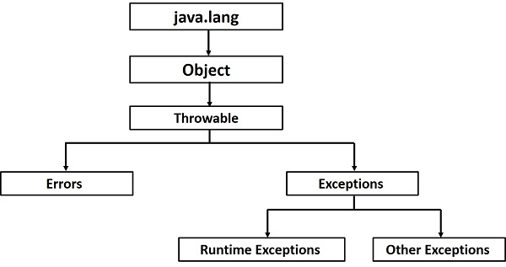
Errors − These are not exceptions at all, but problems that arise beyond the control of the user or the programmer.
e.g. OutOfMemoryError, VirtualMachineError, AssertionError etc.
Exception Hierarchy
All exception classes are subtypes of the java.lang.Exception class.
The exception class is a subclass of the Throwable class. Other than the exception class there is another subclass called Error which is derived from the Throwable class.

Slide 105
Java Exception Keywords
There are 5 keywords which are used in handling exceptions in Java.
Keyword | Description
Try | The "try" keyword is used to specify a block where we should place exception code. The try block must be followed by either catch or finally. It means, we can't use try block alone.
catch | The "catch" block is used to handle the exception. It must be preceded by try block which means we can't use catch block alone. It can be followed by finally block later.
finally | The "finally" block is used to execute the important code of the program. It is executed whether an exception is handled or not
throw | The "throw" keyword is used to throw an exception.
throws | The "throws" keyword is used to declare exceptions. It doesn't throw an exception. It specifies that there may occur an exception in the method. It is always used with method signature.

Slide 106
Java Exception Handling Example
public class JavaExceptionExample{
public static void main(String args[]){
try{
//code that may raise exception
int data=100/0;
}catch(ArithmeticException e){System.out.println(e);}
//rest code of the program
System.out.println("rest of the code...");
}
}
Exception in thread main java.lang.ArithmeticException:/ by zero
rest of the code...

Slide 107
Common Scenarios of Java Exceptions
1) A scenario where ArithmeticException occurs
If we divide any number by zero, there occurs an ArithmeticException.
int a=50/0;//ArithmeticException
2) A scenario where NullPointerException occurs
If we have a null value in any variable, performing any operation on the variable throws a NullPointerException.
String s=null;
System.out.println(s.length());//NullPointerException
3) A scenario where NumberFormatException occurs
The wrong formatting of any value may occur NumberFormatException. Suppose I have a string variable that has characters, converting this variable into digit will occur NumberFormatException.
String s="abc";
int i=Integer.parseInt(s);//NumberFormatException
4) A scenario where ArrayIndexOutOfBoundsException occurs
If you are inserting any value in the wrong index, it would result in ArrayIndexOutOfBoundsException as shown below:
int a[]=new int[5];
a[10]=50; //ArrayIndexOutOfBoundsException

Slide 108
Java try-catch block
Java try block
Java try block is used to enclose the code that might throw an exception. It must be used within the method.
If an exception occurs at the particular statement of try block, the rest of the block code will not execute. So, it is recommended not to keeping the code in try block that will not throw an exception.
Java try block must be followed by either catch or finally block.
Syntax of Java try-catch
try{
//code that may throw an exception
}catch(Exception_class_Name ref){}
Syntax of try-finally block
try{
//code that may throw an exception
}finally{}

Slide 109
Problem without exception handling
public class TryCatchExample1 {
public static void main(String[] args) {
int data=50/0; //may throw exception
System.out.println("rest of the code");
}
}
Solution by exception handling
public class TryCatchExample2 {
public static void main(String[] args) {
try
{
int data=50/0; //may throw exception
}
//handling the exception
catch(ArithmeticException e)
{
System.out.println(e);
}
System.out.println("rest of the code");
}
}

Slide 110
Java catch multiple exceptions
public class MultipleCatchBlock2 {
public static void main(String[] args) {
try{
int a[]=new int[5];
System.out.println(a[10]);
}
catch(ArithmeticException e)
{
System.out.println("Arithmetic Exception occurs");
}
catch(ArrayIndexOutOfBoundsException e)
{
System.out.println("ArrayIndexOutOfBounds Exception occurs");
}
catch(Exception e)
{
System.out.println("Parent Exception occurs");
}
System.out.println("rest of the code");
}
}
public class MultipleCatchBlock1 {
public static void main(String[] args) {
try{
int a[]=new int[5];
a[5]=30/0;
}
catch(ArithmeticException e)
{
System.out.println("Arithmetic Exception occurs");
}
catch(ArrayIndexOutOfBoundsException e)
{
System.out.println("ArrayIndexOutOfBounds Exception occurs");
}
catch(Exception e)
{
System.out.println("Parent Exception occurs");
}
System.out.println("rest of the code");
}
}

Slide 111
public class MultipleCatchBlock4 {
public static void main(String[] args) {
try{
String s=null;
System.out.println(s.length());
}
catch(ArithmeticException e)
{
System.out.println("Arithmetic Exception occurs");
}
catch(ArrayIndexOutOfBoundsException e)
{
System.out.println("ArrayIndexOutOfBounds Exception occurs");
}
catch(Exception e)
{
System.out.println("Parent Exception occurs");
}
System.out.println("rest of the code");
}
}

Slide 112
Java Nested try block
Sometimes a situation may arise where a part of a block may cause one error and the entire block itself may cause another error. In such cases, exception handlers have to be nested.
class Excep6{
public static void main(String args[]){
try{
try{
System.out.println("going to divide");
int b =39/0;
}catch(ArithmeticException e){System.out.println(e);}
try{
int a[]=new int[5];
a[5]=4;
}catch(ArrayIndexOutOfBoundsException e){System.out.println(e);}
System.out.println("other statement);
}catch(Exception e){System.out.println("handeled");}
System.out.println("normal flow..");
}
}
going to divide
java.lang.ArithmeticException: / by zero
java.lang.ArrayIndexOutOfBoundsException: Index 5 out of bounds for length 5
other statement
normal flow..

Slide 113
Java finally block
Java finally block is a block that is used to execute important code such as closing connection, stream etc.
Java finally block is always executed whether exception is handled or not.
Case 1: exception doesn't occur.
class TestFinallyBlock{
public static void main(String args[]){
try{
int data=25/5;
System.out.println(data);
}
catch(NullPointerException e){System.out.println(e);}
finally{System.out.println("finally block is always executed");}
System.out.println("rest of the code...");
}
}
Output:
5
finally block is always executed
rest of the code...
Case 2: exception occurs and not handled.
class TestFinallyBlock1{
public static void main(String args[]){
try{
int data=25/0;
System.out.println(data);
}
catch(NullPointerException e){System.out.println(e);}
finally{System.out.println("finally block is always executed");}
System.out.println("rest of the code...");
}
}
Output:
finally block is always executed
Exception in thread main java.lang.ArithmeticException:/ by zero

Slide 114
Case 3: exception occurs and handled.
public class TestFinallyBlock2{
public static void main(String args[]){
try{
int data=25/0;
System.out.println(data);
}
catch(ArithmeticException e){System.out.println(e);}
finally{System.out.println("finally block is always executed");}
System.out.println("rest of the code...");
}
}
Output: Exception in thread main java.lang.ArithmeticException:/ by zero
finally block is always executed
rest of the code...

Slide 115
Java throw keyword
The Java throw keyword is used to explicitly throw an exception.
We can throw either checked or uncheked exception in java by throw keyword.
The syntax of java throw keyword is given below.
throw exception;
Example
public class TestThrow1{
static void validate(int age){
if(age<18)
throw new ArithmeticException("not valid");
else
System.out.println("welcome to vote");
}
public static void main(String args[]){
validate(13);
System.out.println("rest of the code...");
}
}
Output:
Exception in thread main java.lang.ArithmeticException:not valid

Slide 116
Java throws keyword
The Java throws keyword is used to declare an exception. It gives an information to the programmer that there may occur an exception so it is better for the programmer to provide the exception handling code so that normal flow can be maintained.
Syntax of java throws
return_type method_name() throws exception_class_name{
//method code
}
import java.io.IOException;
class Testthrows1{
void m()throws IOException{
throw new IOException("device error");//checked exception
}
void n()throws IOException{
m();
}
void p(){
try{
n();
}catch(Exception e){System.out.println("exception handled");}
}
public static void main(String args[]){
Testthrows1 obj=new Testthrows1();
obj.p();
System.out.println("normal flow...");
}
}

Slide 117
Java Pass by Value vs Pass by Reference
Pass by Value: The method parameter values are copied to another variable and then the copied variable is passed, that’s why it’s called pass by value.
Pass by Reference: An alias or reference to the actual parameter is passed to the method, that’s why it’s called pass by reference.
Code for pass by value
public class JavaApplication4 {
static void displayPrimitive(int a)
{
System.out.println("Inside Display Primitive method");
a=a+5;
System.out.println("a :"+a);
}
public static void main(String[] args) {
int a =5;
System.out.println("Before the function a: "+a);
displayPrimitive(a);
System.out.println("After the function a: "+a);
}
}
Output:
Before the function a: 5
Inside Display Primitive method
a :10
After the function a: 5

Slide 118
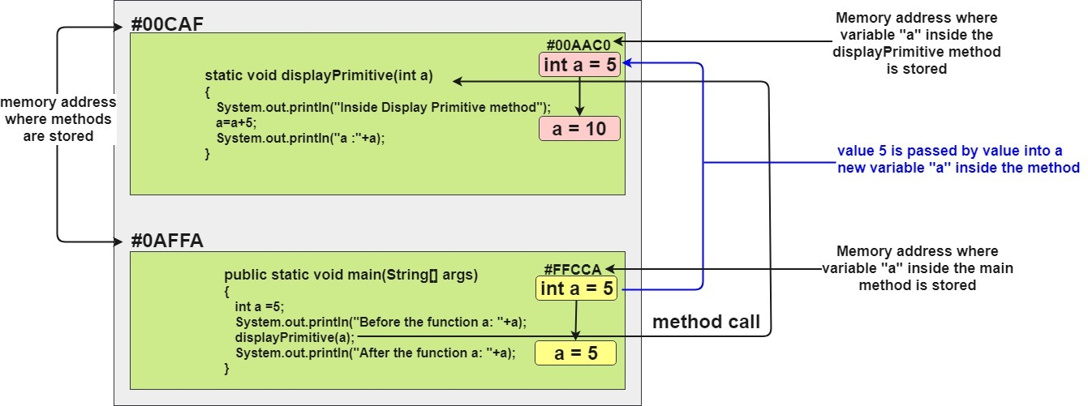

Slide 119
Pass by Reference –
public class JavaApplication4 {
static void displayArray(int[] a)
{
System.out.println("\nInside Display Array method");
a[0]=0; a[1]=0; a[2]=0;
for(int i=0;i<3;i++)
System.out.print(a[i]+" ");
}
public static void main(String[] args) {
int arr[] = {2,2,2};
System.out.println("Before the function");
for(int i=0;i<3;i++)
System.out.print(arr[i]+" ");
displayArray(arr);
System.out.println("\nAfter the function");
for(int i=0;i<3;i++)
System.out.print(arr[i]+" ");
}
}
Output:
Before the method
2 2 2
Inside Display Array method
0 0 0
After the function
0 0 0

Slide 120
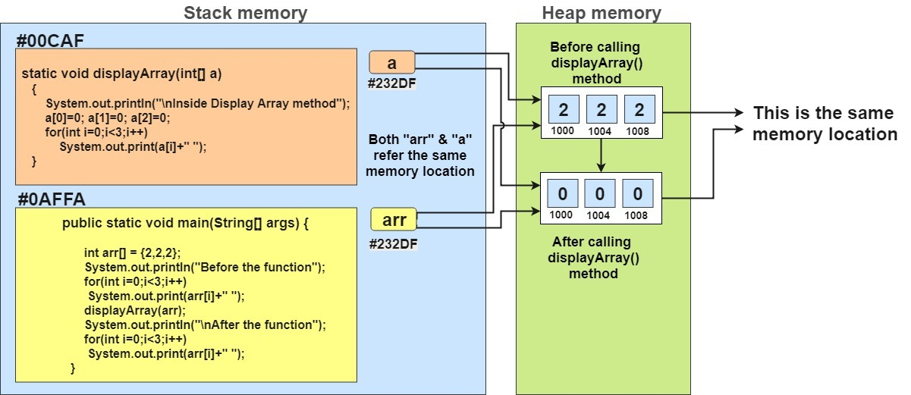

Slide 121
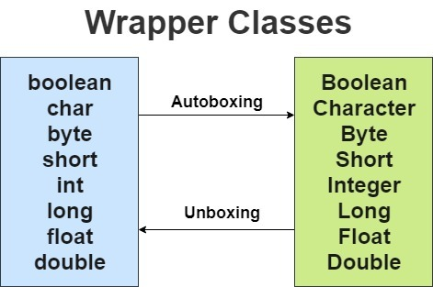
Wrapper Classes in Java | Autoboxing vs Unboxing
The wrapper classes in Java are used to convert primitive types (int, char, float, etc) into corresponding objects.
A Wrapper class is a class whose object wraps or contains a primitive data types.
Wrapper classes in java provides the mechanism to convert primitive into object and object into primitive.
Since J2SE 5.0, autoboxing and unboxing feature converts primitive into object and object into primitive automatically. The automatic conversion of primitive into object is known as autoboxing and vice-versa unboxing.

Slide 122
Autoboxing
Automatic conversion of primitive types to the object of their corresponding wrapper classes is known as autoboxing.
For example – conversion of int to Integer, long to Long, double to Double etc.
The Java compiler applies autoboxing when a primitive value is:
Passed as a parameter to a method that expects an object of the corresponding wrapper class.
Assigned to a variable of the corresponding wrapper class.
Program: Primitive Types to Wrapper Objects
class Main {
public static void main(String[] args) {
// create primitive types
int a = 5;
double b = 5.65;
//converts into wrapper objects
Integer aObj = Integer.valueOf(a);
Double bObj = Double.valueOf(b);
if(aObj instanceof Integer) {
System.out.println("An object of Integer is created.");
}
if(bObj instanceof Double) {
System.out.println("An object of Double is created.");
}
}
}
Output
An object of Integer is created.
An object of Double is created.

Slide 123
However, the Java compiler can directly convert the primitive types into corresponding objects. For example,
int a = 5;
// converts into object
Integer aObj = a;
double b = 5.6;
// converts into object
Double bObj = b;
This process is known as auto-boxing

Slide 124
Unboxing
It is just the reverse process of autoboxing. Converting an object of a wrapper class to its corresponding primitive type is known as unboxing.
The Java compiler applies unboxing when an object of a wrapper class is:
Passed as a parameter to a method that expects a value of the corresponding primitive type.
Wrapper Objects into Primitive Types
class Main {
public static void main(String[] args) {
// creates objects of wrapper class
Integer aObj = Integer.valueOf(23);
Double bObj = Double.valueOf(5.55);
// converts into primitive types
int a = aObj.intValue();
double b = bObj.doubleValue();
System.out.println("The value of a: " + a);
System.out.println("The value of b: " + b);
}
}
Output
The value of a: 23
The value of b: 5.55

Slide 125
However, the Java compiler can automatically convert objects into corresponding primitive types. For example,
Integer aObj = Integer.valueOf(2);
// converts into int type
int a = aObj;
Double bObj = Double.valueOf(5.55);
// converts into double type
double b = bObj;
This process is known as unboxing.

Slide 126
Advantages of Wrapper Classes
In Java, sometimes we might need to use objects instead of primitive data types. For example, while working with collections.
// error
ArrayList<int> list = new ArrayList<>();
// runs perfectly
ArrayList<Integer> list = new ArrayList<>();

Slide 127
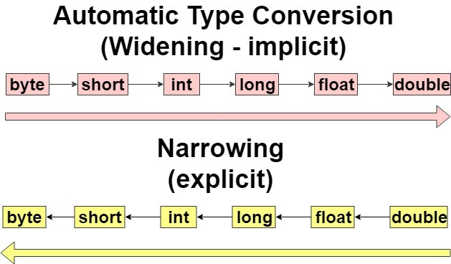
Typecasting in Java
Typecasting in Java is assigning a value of one type to a variable of another type. When you assign value of one data type to another, the two types might not be compatible with each other.
If the data types are compatible, then Java will perform the conversion automatically known as Automatic Type Conversion (Widening ) and if not then they need to be casted or converted explicitly(narrowing).
2 types of Type Casting in java
Automatic Type Conversion (Widening – implicit)
Narrowing (Explicit)

Slide 128
Widening or Automatic Type Conversion
Widening conversion takes place when two data types are automatically converted. This happens when:
The two data types are compatible.
When we assign value of a smaller data type to a bigger data type.
class Test
{
public static void main(String[] args)
{
int i = 100;
//automatic type conversion
long l = i;
System.out.println("Int value "+i);
System.out.println("Long value "+l);
}
}
Output
Int value 100
Long value 100
Float value 100.0

Slide 129
Narrowing or Explicit Type Conversion
If we want to assign a value of larger data type to a smaller data type we perform explicit type casting or narrowing.
This is useful for incompatible data types where automatic conversion cannot be done.
Here, target-type specifies the desired type to convert the specified value to.
class Test
{
public static void main(String[] args)
{
double d = 100.04;
//explicit type casting
long l = (long)d;
//explicit type casting
int i = (int)l;
System.out.println("Double value "+d);
//fractional part lost
System.out.println("Long value "+l);
//fractional part lost
System.out.println("Int value "+i);
}
}
Output
Double value 100.04
Long value 100
Int value 100

Slide 130
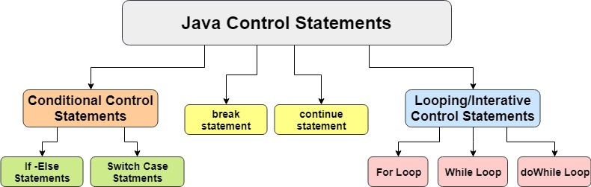
Java Control Statements | Conditional & Looping Control Statements
They are mainly categorized in 2 types –
Conditional Control Statements
Whenever a condition is to be tested depending on which particular tasks are to be performed, Conditional control statements are used.
Looping / Iterative Control Statements
Whenever a particular task has to be iterated for a particular number of times or depending on some condition, Looping control statements are used.

Slide 131
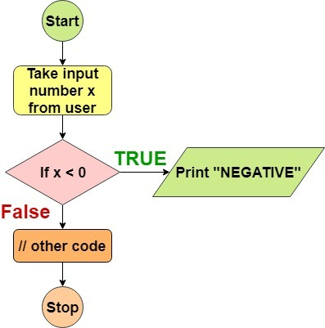
Java If-Else Conditional Statements.
if statement
if-else statement
if-else-if ladder
nested if statement
Java if Statement
The Java if statement tests the condition. It executes the if block if condition is true.
if(condition){
//code to be executed
}
public class IfExample {
public static void main(String[] args) {
int num=20;
if(num>0){
System.out.print("Positive");
}
}
}

Slide 132
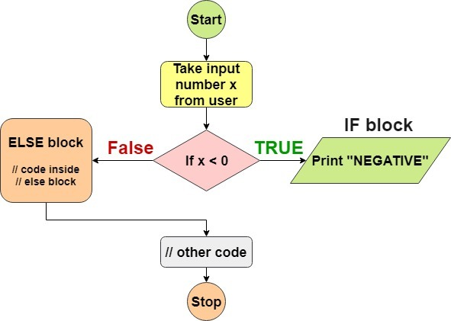
Java if-else Statement
The Java if-else statement also tests the condition. It executes the if block if condition is true otherwise else block is executed.
if(condition){
//code if condition is true
}else{
//code if condition is false
}
public class IfElseExample {
public static void main(String[] args) {
int number=13;
if(number%2==0){
System.out.println("even number");
}else{
System.out.println("odd number");
}
}
}

Slide 133
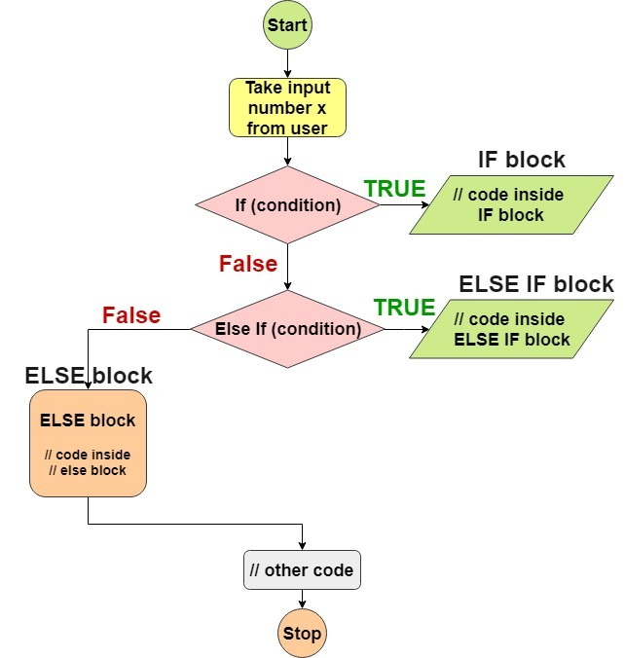
Java if-else-if ladder Statement
The if-else-if ladder statement executes one condition from multiple statements. It is used when more than 1 condition is to be checked in relation with the problem.
if(condition1){
//code to be executed if condition1 is true
}else if(condition2){
//code to be executed if condition2 is true
}
else if(condition3){
//code to be executed if condition3 is true
}
...
else{
//code to be executed if all the conditions are false
}
public class IfElseIfExample {
public static void main(String[] args) {
int num=0;
if(num<0){
System.out.println("Negative");
}
else if(num>0){
System.out.println("Positive");
}
}else{
System.out.println("Neither Negative nor Positive");
}
}
}

Slide 134
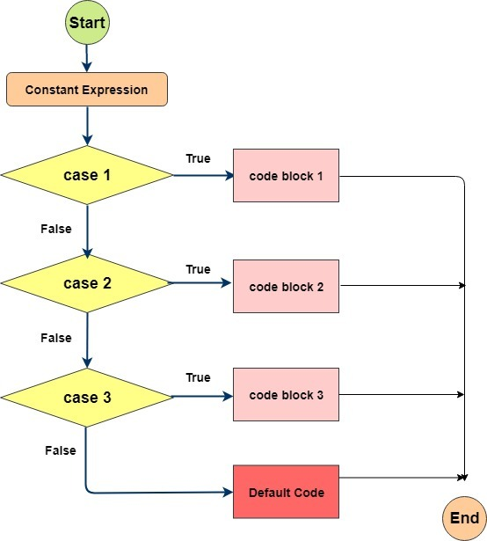
Java Switch Case Statement
The Java switch statement executes one statement from multiple conditions. It is like if-else-if ladder statement. It is a multi-way branch statement.
public class SwitchExample {
public static void main(String[] args) {
int number=20;
switch(number){
case 10: System.out.println("10");break;
case 20: System.out.println("20");break;
case 30: System.out.println("30");break;
default:System.out.println("Not in 10, 20 or 30");
}
}
}

Slide 135
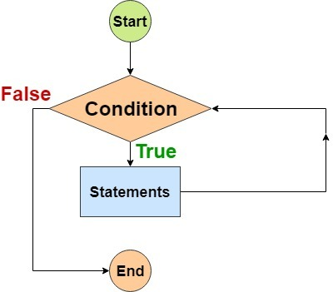
While Loop
The Java while loop is used to iterate a part of the program several times. If the number of iteration is not fixed, it is recommended to use while loop. Usually while loop is used to when we don’t know how many times do we need to iterate the loop in advanced or the number of iterations is based on some condition.
while(condition){
//code to be executed
}
public class WhileExample {
public static void main(String[] args) {
int i=1;
while(i<=10){
System.out.println(i);
i++;
}
}
}

Slide 136
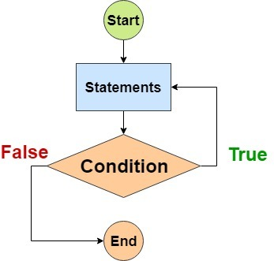
do-while Loop
The Java do-while loop is used to iterate a part of the program several times. If the number of iteration is not fixed and you must have to execute the loop at least once, it is recommended to use do-while loop. The Java do-while loop is executed at least once because condition is checked after loop body.
public class DoWhileExample {
public static void main(String[] args) {
int i=10;
do{
System.out.println(i); // the loop will execute once even when i=10 and condition is i<10
i++;
}while(i<10);
}
}

Slide 137
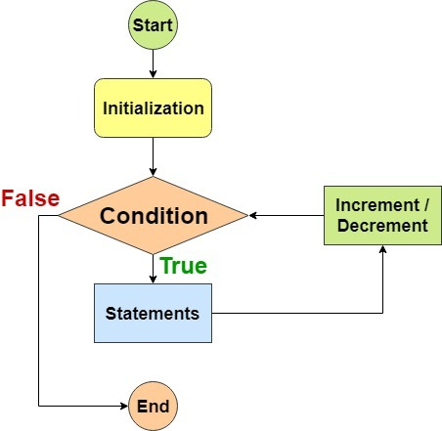
For Loop
The Java for loop is used to iterate a part of the program several times. If the number of iteration is fixed, it is recommended to use for loop. Typically used when number of iterations in pre defined or already known.
for loop syntax
for(initialization;condition;incr/decr){
//code to be executed
}
for(initialization;condition;incr/decr){
//code to be executed
}
public class ForExample {
public static void main(String[] args) {
for(int i=1;i<=10;i++){
System.out.println(i);
}
}
}

Slide 138
Basic Concepts required to understand Collections
Variables concept
int x=10, y=20,z=30; // 10000 values …. Worst practice
Arrays
Student[] s = new student[10000]; 0,1,2,…..9999
Limitations of arrays
Fixed Size( You cant change once the size is fixed)
Homogeneous
No standard method (readymade methods are not supported)
treeset collection contains insert() , contains (),clear(), remove()
Collections
Size is growable in nature
Both homogeneous and heterogenous
Readymade ds available
Collection vs collection framework
Collection(I) : group of individual objects as a single unit
Student <- S1,s2,s3…sn
Collection framework: Several classes and interfaces is required / used to implement collection.(sort , search)
Java : collection , Collection Framework
C++: Containers , STL

Slide 139
9 key interfaces in CF (Collection Interface and Map Interface)
1 Collection(I)- root Interface
2 List (I) :Duplicates allowed , Insertion order is preserved .
Cls implement ( AL , LL , Vector , Stack)
3 set (I) : duplicates not allowed , insertion order not preserved.(2,4,1)
4 sorted set(I)
5 Navigable Sorted Set(I)
Cls implemented (Treeset)
6 queue (I)
Cls implemented PQ

Slide 140
7 Map Interface – Root Interface (Key value pair) {1:srikanth , 2:suresh}
Keys: Duplictaes not allowed , values :Duplictaes allowed
Cls implemented ( Hasmap , linked hashmap)
8sorted map (I) : (K:V) in some sorted order
9 navigable map(I)
Cls implemented is Tree map
{1:cse , 2:ise , 3:mech , 1:ece}

Slide 141
Collection in Java
Any group of individual objects which are represented as a single unit is known as the collection of the objects.
In Java, a separate framework named the “Collection Framework” has been defined in JDK 1.2 which holds all the collection classes and interface in it.
The Collection interface (java.util.Collection) and Map interface (java.util.Map) are the two main “root” interfaces of Java collection classes.

Slide 142
Before Collection Framework(or before JDK 1.2)
Before Collection Framework(or before JDK 1.2) was introduced, the standard methods for grouping Java objects (or collections) were Arrays or Vectors or Hashtables.
All of these collections had no common interface. Therefore, though the main aim of all the collections are same, the implementation of all these collections were defined independently and had no correlation among them.
And also, its very difficult for the users to remember all the different methods, syntax and constructors present in every collection class.

Slide 143
// Java program to demonstrate
// why collection framework was needed
import java.io.*;
import java.util.*;
class CollectionDemo {
public static void main(String[] args)
{
// Creating instances of the array,vector and hashtable
int arr[] = new int[] { 1, 2, 3, 4 };
Vector<Integer> v = new Vector();
Hashtable<Integer, String> h
= new Hashtable();
// Adding the elements into the vector
v.addElement(1);
v.addElement(2);
// Adding the element into the hashtable
h.put(1, "geeks");
h.put(2, "4geeks");
// Array instance creation requires [],
// while Vector and hastable require ()
// Vector element insertion requires
addElement(),
// but hashtable element insertion requires put()
// Accessing the first element of the
// array, vector and hashtable
System.out.println(arr[0]);
System.out.println(v.elementAt(0));
System.out.println(h.get(1));
// Array elements are accessed using [],
// vector elements using elementAt()
// and hashtable elements using get()
}
}
Output:
1
1
geeks

Slide 144
Disadvantages
As we can observe, none of these collections(Array, Vector or Hashtable) implements a standard member access interface, it was very difficult for programmers to write algorithms that can work for all kinds of Collections.
Another drawback is that most of the ‘Vector’ methods are final, meaning we cannot extend the ’Vector’ class to implement a similar kind of Collection.
Therefore, Java developers decided to come up with a common interface to deal with the above-mentioned problems
Introduced the Collection Framework in JDK 1.2 post which both, legacy Vectors and Hashtables were modified to conform to the Collection Framework.

Slide 145
Advantages of the Collection Framework:
Consistent API: The API has a basic set of interfaces like Collection, Set, List, or Map, all the classes (ArrayList, LinkedList, Vector, etc) that implement these interfaces have some common set of methods.
Reduces programming effort: A programmer doesn’t have to worry about the design of the Collection but rather he can focus on its best use in his program. Therefore, the basic concept of Object-oriented programming (i.e.) abstraction has been successfully implemented.
Increases program speed and quality: Increases performance by providing high-performance implementations of useful data structures and algorithms because in this case, the programmer need not think of the best implementation of a specific data structure. He can simply use the best implementation to drastically boost the performance of his algorithm/program.

Slide 146
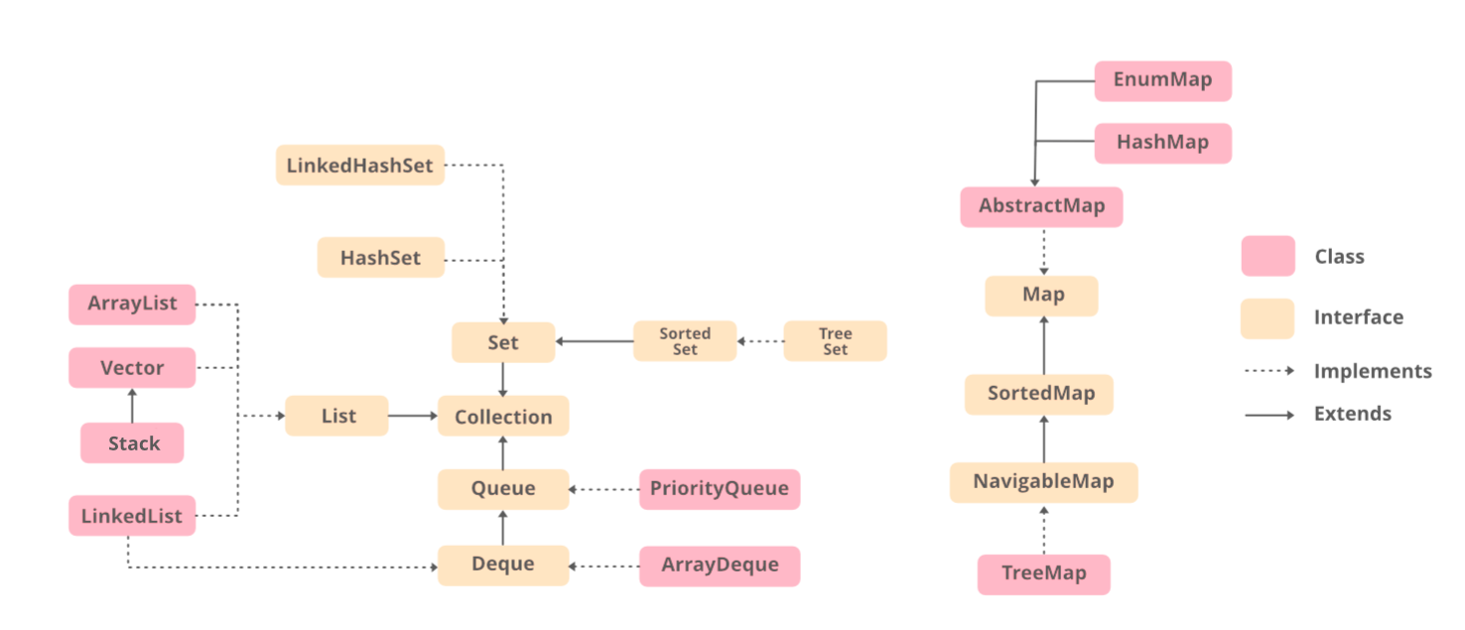

Slide 147
Methods of the Collection Interface
Method Description
add(Object) This method is used to add an object to the collection.
addAll(Collection c) This method adds all the elements in the given collection to this collection.
clear() This method removes all of the elements from this collection.
contains(Object o) This method returns true if the collection contains the specified element.
containsAll(Collection c) This method returns true if the collection contains all of the elements in the given collection.
equals(Object o) This method compares the specified object with this collection for equality.
hashCode() This method is used to return the hash code value for this collection.
isEmpty() This method returns true if this collection contains no elements.
iterator() This method returns an iterator over the elements in this collection.
max() This method is used to return the maximium value present in the collection.
parallelStream() This method returns a parallel Stream with this collection as its source.
remove(Object o) This method is used to remove the given object from the collection. If there are duplicate values, then this method removes the first occurrence of the object.
removeAll(Collection c) This method is used to remove all the objects mentioned in the given collection from the collection.
removeIf(Predicate filter) This method is used to removes all the elements of this collection that satisfy the given predicate.
retainAll(Collection c) This method is used to retains only the elements in this collection that are contained in the specified collection.
size() This method is used to return the number of elements in the collection.
spliterator() This method is used to create a Spliterator over the elements in this collection.
stream() This method is used to return a sequential Stream with this collection as its source.
toArray() This method is used to return an array containing all of the elements in this collection.

Slide 148
Interfaces which extend the Collections Interface
The collection framework contains multiple interfaces where every interface is used to store a specific type of data. The following are the interfaces present in the framework.
Iterable Interface :
Collection Interface
List Interface : Array List , Linked list , Vector , stack
Queue Interface : Priority queue
Deque Interface : array Dequeue
Set Interface : Hashset , Linked hashset
Sorted Set Interface :Treeset
Map Interface : Hashmap

Slide 149
1 Iterable Interface:
This is the root interface for the entire collection framework. The collection interface extends the iterable interface.
Therefore, inherently, all the interfaces and classes implement this interface.
The main functionality of this interface is to provide an iterator for the collections. Therefore, this interface contains only one abstract method which is the iterator.
It returns the Iterator iterator();
2 Collection Interface:
This interface extends the iterable interface and is implemented by all the classes in the collection framework.
This interface contains all the basic methods which every collection has like adding the data into the collection, removing the data, clearing the data, etc.
All these methods are implemented in this interface because these methods are implemented by all the classes irrespective of their style of implementation.

Slide 150
3 List Interface:
This is a child interface of the collection interface.
This interface is dedicated to the data of the list type in which we can store all the ordered collection of the objects.
This also allows duplicate data to be present in it. This list interface is implemented by various classes like ArrayList, Vector, linked list , Stack, etc.
Since all the subclasses implement the list, we can instantiate a list object with any of these classes.
For example,
List <T> al = new ArrayList<> ();
List <T> ll = new LinkedList<> ();
List <T> v = new Vector<> ();
Where T is the type of the object

Slide 151
The classes which implement the List interface are as follows:
3. a ArrayList:
ArrayList provides us with dynamic arrays in Java. Though, it may be slower than standard arrays but can be helpful in programs where lots of manipulation in the array is needed.
The size of an ArrayList is increased automatically if the collection grows or shrinks if the objects are removed from the collection.
Java ArrayList allows us to randomly access the list. ArrayList can not be used for primitive types, like int, char, etc. We will need a wrapper class for such cases.

Slide 152
// Java program to demonstrate the
// working of ArrayList in Java
import java.io.*;
import java.util.*;
class GFG {
public static void main(String[] args)
{
// Declaring the ArrayList with
// initial size n
ArrayList<Integer> al
= new ArrayList<Integer>();
// Appending new elements at
// the end of the list
for (int i = 1; i <= 5; i++)
al.add(i);
// Printing elements
System.out.println(al);
// Remove element at index 3
al.remove(3);
// Displaying the ArrayList
// after deletion
System.out.println(al);
// Printing elements one by one
for (int i = 0; i < al.size(); i++)
System.out.print(al.get(i) + " ");
}
}
Output:
[1, 1, 3, 4, 5]
[1, 2, 3, 5]
1 2 3 5

Slide 153
3.B LinkedList:
LinkedList class is an implementation of the LinkedList data structure which is a linear data structure where the elements are not stored in contiguous locations and every element is a separate object with a data part and address part.
The elements are linked using pointers and addresses. Each element is known as a node.

Slide 154
// Java program to demonstrate the
// working of LinkedList in Java
import java.io.*;
import java.util.*;
class GFG {
public static void main(String[] args)
{
// Declaring the LinkedList
LinkedList<Integer> ll
= new LinkedList<Integer>();
// Appending new elements at
// the end of the list
for (int i = 1; i <= 5; i++)
ll.add(i);
// Printing elements
System.out.println(ll);
// Remove element at index 3
ll.remove(3);
// Displaying the List
// after deletion
System.out.println(ll);
// Printing elements one by one
for (int i = 0; i < ll.size(); i++)
System.out.print(ll.get(i) + " ");
}
}
Output:
[1, 2, 3, 4, 5]
[1, 2, 3, 5]
1 2 3 5

Slide 155
3.C Vector:
A vector provides us with dynamic arrays in Java. Though, it may be slower than standard arrays but can be helpful in programs where lots of manipulation in the array is needed.
This is identical to ArrayList in terms of implementation. However, the primary difference between a vector and an ArrayList is that a Vector is synchronized and an ArrayList is non-synchronized

Slide 156
// Java program to demonstrate the
// working of Vector in Java
import java.io.*;
import java.util.*;
class GFG {
public static void main(String[] args)
{
// Declaring the Vector
Vector<Integer> v
= new Vector<Integer>();
// Appending new elements at
// the end of the list
for (int i = 1; i <= 5; i++)
v.add(i);
// Printing elements
System.out.println(v);
// Remove element at index 3
v.remove(3);
// Displaying the Vector
// after deletion
System.out.println(v);
// Printing elements one by one
for (int i = 0; i < v.size(); i++)
System.out.print(v.get(i) + " ");
}
}
Output:
[1, 2, 3, 4, 5]
[1, 2, 3, 5]
1 2 3 5

Slide 157
3.D Stack
Stack class models and implements the Stack data structure.
The class is based on the basic principle of last-in-first-out.
In addition to the basic push and pop operations, the class provides three more functions of empty, search and peek.

Slide 158
// Java program to demonstrate the
// working of a stack
import java.util.*;
public class GFG {
public static void main(String args[])
{
Stack<String> stack = new Stack<String>();
stack.push("Geeks");
stack.push("For");
stack.push("Geeks");
stack.push("Geeks");
// Iterator for the stack
Iterator<String> itr
= stack.iterator();
// Printing the stack
while (itr.hasNext()) {
System.out.print(itr.next() + " ");
}
System.out.println();
stack.pop();
// Iterator for the stack
itr
= stack.iterator();
// Printing the stack
while (itr.hasNext()) {
System.out.print(itr.next() + " ");
}
}
}
Output:
Geeks For Geeks Geeks
Geeks For Geeks

Slide 159
4. Queue Interface:
As the name suggests, a queue interface maintains the FIFO(First In First Out) order similar to a real-world queue line.
This interface is dedicated to storing all the elements where the order of the elements matter. For example, whenever we try to book a ticket, the tickets are sold at the first come first serve basis. Therefore, the person whose request arrives first into the queue gets the ticket.
There are various classes like PriorityQueue, Deque, ArrayDeque, etc. Since all these subclasses implement the queue, we can instantiate a queue object with any of these classes.
For example,
Queue <T> pq = new PriorityQueue<> ();
Queue <T> ad = new ArrayDeque<> ();
Where T is the type of the object.

Slide 160
4.A Priority Queue:
A PriorityQueue is used when the objects are supposed to be processed based on the priority.
It is known that a queue follows the First-In-First-Out algorithm, but sometimes the elements of the queue are needed to be processed according to the priority and this class is used in these cases.
The PriorityQueue is based on the priority heap.
// Java program to demonstrate the working of
// priority queue in Java
import java.util.*;
class GfG {
public static void main(String args[])
{
// Creating empty priority queue
PriorityQueue<Integer> pQueue
= new PriorityQueue<Integer>();
// Adding items to the pQueue using add()
pQueue.add(10);
pQueue.add(20);
pQueue.add(15);
// Printing the top element of PriorityQueue
System.out.println(pQueue.peek());
// Printing the top element and removing it
// from the PriorityQueue container
System.out.println(pQueue.poll());
// Printing the top element again
System.out.println(pQueue.peek());
}
}
Output:
10
10
15

Slide 161
5. Deque Interface: This is a very slight variation of the queue data structure.
Deque, also known as a double-ended queue, is a data structure where we can add and remove the elements from both the ends of the queue.
This interface extends the queue interface. The class which implements this interface is ArrayDeque. Since this class implements the deque, we can instantiate a deque object with this class.
For example,
Deque<T> ad = new ArrayDeque<> ();
Where T is the type of the object.
The class which implements the deque interface is ArrayDeque.
ArrayDeque: ArrayDeque class which is implemented in the collection framework provides us with a way to apply resizable-array. This is a special kind of array that grows and allows users to add or remove an element from both sides of the queue.

Slide 162
// Java program to demonstrate the
// ArrayDeque class in Java
import java.util.*;
public class ArrayDequeDemo {
public static void main(String[] args)
{
// Initializing an deque
ArrayDeque<Integer> de_que
= new ArrayDeque<Integer>(10);
// add() method to insert
de_que.add(10);
de_que.add(20);
de_que.add(30);
de_que.add(40);
de_que.add(50);
System.out.println(de_que);
// clear() method
de_que.clear();
// addFirst() method to insert the
// elements at the head
de_que.addFirst(564);
de_que.addFirst(291);
// addLast() method to insert the
// elements at the tail
de_que.addLast(24);
de_que.addLast(14);
System.out.println(de_que);
}
}
Output:
[10, 20, 30, 40, 50]
[264,291, 564, 24, 14]

Slide 163
6 Set Interface:
A set is an unordered collection of objects in which duplicate values cannot be stored.
This collection is used when we wish to avoid the duplication of the objects and wish to store only the unique objects.
This set interface is implemented by various classes like HashSet, TreeSet, LinkedHashSet, etc.
Since all the subclasses implement the set, we can instantiate a set object with any of these classes. For example,
Set<T> hs = new HashSet<> ();
Set<T> lhs = new LinkedHashSet<> ();
Set<T> ts = new TreeSet<> ();
Where T is the type of the object.

Slide 164
6.A HashSet:
The HashSet class is an inherent implementation of the hash table data structure.
The objects that we insert into the HashSet do not guarantee to be inserted in the same order. The objects are inserted based on their hashcode. This class also allows the insertion of NULL elements.
// Java program to demonstrate the
// working of a HashSet
import java.util.*;
public class HashSetDemo {
public static void main(String args[])
{
// Creating HashSet and
// adding elements
HashSet<String> hs = new HashSet<String>();
hs.add("Geeks");
hs.add("For");
hs.add("Geeks");
hs.add("Is");
hs.add("Very helpful");
// Traversing elements
Iterator<String> itr = hs.iterator();
while (itr.hasNext()) {
System.out.println(itr.next());
}
}
}
Output:
Very helpful
Geeks
For
Is

Slide 165
6.B LinkedHashSet:
A LinkedHashSet is very similar to a HashSet. The difference is that this uses a doubly linked list to store the data and retains the ordering of the elements.
// Java program to demonstrate the
// working of a LinkedHashSet
import java.util.*;
public class LinkedHashSetDemo {
public static void main(String args[])
{
// Creating LinkedHashSet and
// adding elements
LinkedHashSet<String> lhs
= new LinkedHashSet<String>();
lhs.add("Geeks");
lhs.add("For");
lhs.add("Geeks");
lhs.add("Is");
lhs.add("Very helpful");
// Traversing elements
Iterator<String> itr = lhs.iterator();
while (itr.hasNext()) {
System.out.println(itr.next());
}
}
}
Output:
Geeks
For
Is

Slide 166
7. Sorted Set Interface:
This interface is very similar to the set interface. The only difference is that this interface has extra methods that maintain the ordering of the elements.
The sorted set interface extends the set interface and is used to handle the data which needs to be sorted. The class which implements this interface is TreeSet.
Since this class implements the SortedSet, we can instantiate a SortedSet object with this class. For example,
SortedSet<T> ts = new TreeSet<> ();
Where T is the type of the object.

Slide 167
The class which implements the sorted set interface is TreeSet.
7.A TreeSet: The TreeSet class uses a Tree for storage. The ordering of the elements is maintained by a set using their natural ordering whether or not an explicit comparator is provided.
This must be consistent with equals if it is to correctly implement the Set interface.
It can also be ordered by a Comparator provided at set creation time, depending on which constructor is used.
// Java program to demonstrate the
// working of a TreeSet
import java.util.*;
public class TreeSetDemo {
public static void main(String args[])
{
// Creating TreeSet and
// adding elements
TreeSet<String> ts
= new TreeSet<String>();
ts.add("Geeks");
ts.add("For");
ts.add("Geeks");
ts.add("Is");
ts.add("Very helpful");
// Traversing elements
Iterator<String> itr = ts.iterator();
while (itr.hasNext()) {
System.out.println(itr.next());
}
}
}
Output:
For
Geeks
Is
Very helpful

Slide 168
8. Map Interface:
A map is a data structure which supports the key-value pair mapping for the data.
This interface doesn’t support duplicate keys because the same key cannot have multiple mappings.
A map is useful if there is a data and we wish to perform operations on the basis of the key.
This map interface is implemented by various classes like HashMap, TreeMap etc.
Since all the subclasses implement the map, we can instantiate a map object with any of these classes. For example,
Map<T> hm = new HashMap<> ();
Map<T> tm = new TreeMap<> ();
Where T is the type of the object.

Slide 169
8.A HashMap:
HashMap provides the basic implementation of the Map interface of Java. It stores the data in (Key, Value) pairs.
To access a value in a HashMap, we must know its key. HashMap uses a technique called Hashing.
Hashing is a technique of converting a large String to small String that represents the same String so that the indexing and search operations are faster.
// Java program to demonstrate the
// working of a HashMap
import java.util.*;
public class HashMapDemo {
public static void main(String args[])
{
// Creating HashMap and
// adding elements
HashMap<Integer, String> hm
= new HashMap<Integer, String>();
hm.put(1, "Geeks");
hm.put(2, "For");
hm.put(3, "Geeks");
// Finding the value for a key
System.out.println("Value for 1 is " + hm.get(1));
// Traversing through the HashMap
for (Map.Entry<Integer, String> e : hm.entrySet())
System.out.println(e.getKey() + " " + e.getValue());
}
}
Output:
Value for 1 is Geeks
1 Geeks
2 For
3 Geeks

Slide 170
Generics in Java
Generics was added in Java 5 to provide compile-time type checking and removing risk of ClassCastException that was common while working with collection classes. The whole collection framework was re-written to use generics for type-safety.
List list = new ArrayList();
list.add("abc");
list.add(new Integer(5)); //OK
for(Object obj : list){
//type casting leading to ClassCastException at runtime
String str=(String) obj;
}
Above code compiles fine but throws ClassCastException at runtime because we are trying to cast Object in the list to String whereas one of the element is of type Integer.

Slide 171
After Java 5, we use collection classes like below.
List<String> list1 = new ArrayList<String>();
// java 7 ? List<String> list1 = new ArrayList<>();
list1.add("abc");
//list1.add(new Integer(5)); //compiler error
for(String str : list1){
//no type casting needed, avoids ClassCastException
}
Notice that at the time of list creation, we have specified that the type of elements in the list will be String. So if we try to add any other type of object in the list, the program will throw compile-time error. Also notice that in for loop, we don’t need typecasting of the element in the list, hence removing the ClassCastException at runtime.

Slide 172
Generic Class
Like C++, we use <> to specify parameter types in generic class creation. To create objects of generic class, we use following syntax.
// To create an instance of generic class
BaseType <Type> obj = new BaseType <Type>()
// A Simple Java program to show working of user defined
// Generic classes
// We use < > to specify Parameter type
class Test<T>
{
// An object of type T is declared
T obj;
Test(T obj)
{ this.obj = obj; } // constructor
public T getObject() { return this.obj; }
}
// Driver class to test above
class Main
{
public static void main (String[] args)
{
// instance of Integer type
Test <Integer> iObj = new Test<Integer>(15);
System.out.println(iObj.getObject());
// instance of String type
Test <String> sObj =
new Test<String>("GeeksForGeeks");
System.out.println(sObj.getObject());
}
}
Output:
15
GeeksForGeeks

Slide 173
We can also pass multiple Type parameters in Generic classes.
// A Simple Java program to show multiple
// type parameters in Java Generics
// We use < > to specify Parameter type
class Test<T, U>
{
T obj1; // An object of type T
U obj2; // An object of type U
// constructor
Test(T obj1, U obj2)
{
this.obj1 = obj1;
this.obj2 = obj2;
}
// To print objects of T and U
public void print()
{
System.out.println(obj1);
System.out.println(obj2);
}
}
// Driver class to test above
class Main
{
public static void main (String[] args)
{
Test <String, Integer> obj =
new Test<String, Integer>("GfG", 15);
obj.print();
}
}
Output:
GfG
15

Slide 174
Generic Functions:
We can also write generic functions that can be called with different types of arguments based on the type of arguments passed to generic method, the compiler handles each method.
// A Simple Java program to show working of user defined
// Generic functions
class Test
{
// A Generic method example
static <T> void genericDisplay (T element)
{
System.out.println(element.getClass().getName() +
" = " + element);
}
// Driver method
public static void main(String[] args)
{
// Calling generic method with Integer argument
genericDisplay(11);
// Calling generic method with String argument
genericDisplay("GeeksForGeeks");
// Calling generic method with double argument
genericDisplay(1.0);
}
}
Output :
java.lang.Integer = 11
java.lang.String = GeeksForGeeks
java.lang.Double = 1.0

Slide 175
Advantages of Generics:
Programs that uses Generics has got many benefits over non-generic code.
Code Reuse: We can write a method/class/interface once and use for any type we want.
Type Safety : Generics make errors to appear compile time than at run time (It’s always better to know problems in your code at compile time rather than making your code fail at run time). Suppose you want to create an ArrayList that store name of students and if by mistake programmer adds an integer object instead of string, compiler allows it. But, when we retrieve this data from ArrayList, it causes problems at runtime.
// A Simple Java program to demonstrate that NOT using
// generics can cause run time exceptions
import java.util.*;
class Test
{
public static void main(String[] args)
{
// Creatinga an ArrayList without any type specified
ArrayList al = new ArrayList();
al.add("Sachin");
al.add("Rahul");
al.add(10); // Compiler allows this
String s1 = (String)al.get(0);
String s2 = (String)al.get(1);
// Causes Runtime Exception
String s3 = (String)al.get(2);
}
}
Output :
Exception in thread "main" java.lang.ClassCastException:
java.lang.Integer cannot be cast to java.lang.String
at Test.main(Test.java:19)

Slide 176
How generics solve this problem?
At the time of defining ArrayList, we can specify that this list can take only String objects.
// Using generics converts run time exceptions into
// compile time exception.
import java.util.*;
class Test
{
public static void main(String[] args)
{
// Creating a an ArrayList with String specified
ArrayList <String> al = new ArrayList<String> ();
al.add("Sachin");
al.add("Rahul");
// Now Compiler doesn't allow this
al.add(10);
String s1 = (String)al.get(0);
String s2 = (String)al.get(1);
String s3 = (String)al.get(2);
}
}
Output:
15: error: no suitable method found for add(int)
al.add(10);

Slide 177
Individual Type Casting is not needed: If we do not use generics, then, in the above example every-time we retrieve data from ArrayList, we have to typecast it. Typecasting at every retrieval operation is a big headache. If we already know that our list only holds string data then we need not to typecast it every time
// We don't need to typecast individual members of ArrayList
import java.util.*;
class Test
{
public static void main(String[] args)
{
// Creating a an ArrayList with String specified
ArrayList <String> al = new ArrayList<String> ();
al.add("Sachin");
al.add("Rahul");
// Typecasting is not needed
String s1 = al.get(0);
String s2 = al.get(1);
}
}
Generics promotes code reusability.
Implementing generic algorithms: By using generics, we can implement algorithms that work on different types of objects and at the same they are type safe too.

Slide 178
Bounded types with generics in Java
There may be times when you want to restrict the types that can be used as type arguments in a parameterized type. For example, a method that operates on numbers might only want to accept instances of Number or its subclasses
Declare a bounded type parameter
List the type parameter’s name.
Along by the extends keyword
And by its upper bound.(which in below example is A.)
Syntax
<T extends superClassName>

Slide 179
Let’s take an example on how to implement bounded types (extend superclass) with generics.
// This class only accepts type parametes as any class
// which extends class A or class A itself.
// Passing any other type will cause compiler time error
class B extends A
{
public void displayClass()
{
System.out.println("Inside sub class B");
}
}
class C extends A
{
public void displayClass()
{
System.out.println("Inside sub class C");
}
}
public class BoundedClass
{
public static void main(String a[])
{
// Creating object of sub class C and
// passing it to Bound as a type parameter.
Bound<C> bec = new Bound<C>(new C());
bec.doRunTest();
// Creating object of sub class B and
// passing it to Bound as a type parameter.
Bound<B> beb = new Bound<B>(new B());
beb.doRunTest();
// similarly passing super class A
Bound<A> bea = new Bound<A>(new A());
bea.doRunTest();
}
}
Output :
Inside sub class C
Inside sub class B
Inside super class A
class Bound<T extends A>
{
private T objRef;
public Bound(T obj){
this.objRef = obj;
}
public void doRunTest(){
this.objRef.displayClass();
}
}
class A
{
public void displayClass()
{
System.out.println("Inside super class A");
}
}

Slide 180
Now, we restricted to only of type A and its sub classes, So it will throw an error for any other type or sub classes.
// This class only accepts type parametes as any class
// which extends class A or class A itself.
// Passing any other type will cause compiler time error
class B extends A
{
public void displayClass()
{
System.out.println("Inside sub class B");
}
}
class C extends A
{
public void displayClass()
{
System.out.println("Inside sub class C");
}
}
public class BoundedClass
{
public static void main(String a[])
{
// Creating object of sub class C and
// passing it to Bound as a type parameter.
Bound<C> bec = new Bound<C>(new C());
bec.doRunTest();
// Creating object of sub class B and
// passing it to Bound as a type parameter.
Bound<B> beb = new Bound<B>(new B());
beb.doRunTest();
// similarly passing super class A
Bound<A> bea = new Bound<A>(new A());
bea.doRunTest();
Bound<String> bes = new Bound<String>(new String());
bea.doRunTest();
}
}
Output :
error: type argument String is not within bounds of type-variable T
class Bound<T extends A>
{
private T objRef;
public Bound(T obj){
this.objRef = obj;
}
public void doRunTest(){
this.objRef.displayClass();
}
}
class A
{
public void displayClass()
{
System.out.println("Inside super class A");
}
}

Slide 181
Multiple Bounds
Bounded type parameters can be used with methods as well as classes and interfaces.
Java Generics supports multiple bounds also, i.e . In this case A can be an interface or class. If A is class then B and C should be interfaces. We can’t have more than one class in multiple bounds.
Syntax
<T extends superClassName & Interface>
class A implements B
{
public void displayClass()
{
System.out.println("Inside super class A");
}
}
public class BoundedClass
{
public static void main(String a[])
{
//Creating object of sub class A and
//passing it to Bound as a type parameter.
Bound<A> bea = new Bound<A>(new A());
bea.doRunTest();
}
}
Output :
Inside super class A
class Bound<T extends A & B>
{
private T objRef;
public Bound(T obj){
this.objRef = obj;
}
public void doRunTest(){
this.objRef.displayClass();
}
}
interface B
{
public void displayClass();
}

Slide 182
Defining bounded-types for class
You can declare a bound parameter just by extending the required class with the type-parameter, within the angular braces as −
class Sample <T extends Number>
class Sample <T extends Number>{
T data;
Sample(T data){
this.data = data;
}
public void display() {
System.out.println("Data value is: "+this.data);
}
}
public class BoundsExample {
public static void main(String args[]) {
Sample<Integer> obj1 = new Sample<Integer>(20);
obj1.display();
Sample<Double> obj2 = new Sample<Double>(20.22d);
obj2.display();
Sample<Float> obj3 = new Sample<Float>(125.332f);
obj3.display();
}
}
Output
Data value is: 20
Data value is: 20.22
Data value is: 125.332
Note:Now, if you pass other types as parameters to this class (say, String for example) a compile time error will be generated.

Slide 183
Example
public class BoundsExample {
public static void main(String args[]) {
Sample<Integer> obj1 = new Sample<Integer>(20);
obj1.display();
Sample<Double> obj2 = new Sample<Double>(20.22d);
obj2.display();
Sample<String> obj3 = new Sample<String>("Krishna");
obj3.display();
}
}
Compile time error
BoundsExample.java:16: error: type argument String is not within bounds of type-variable T
Sample<String> obj3 = new Sample<String>("Krishna");
^
where T is a type-variable:
T extends Number declared in class Sample
BoundsExample.java:16: error: type argument String is not within bounds of type-variable T
Sample<String> obj3 = new Sample<String>("Krishna"); ^
where T is a type-variable:
T extends Number declared in class Sample
2 errors

Slide 184
Wildcards in Java
The question mark (?) is known as the wildcard in generic programming .
It represents an unknown type.
The wildcard can be used in a variety of situations such as the type of a parameter, field, or local variable, sometimes as a return type.
Types of wildcards in Java:
Upper Bounded Wildcards: These wildcards can be used when you want to relax the restrictions on a variable.
For example, say you want to write a method that works on List < integer >, List < double >, and List < number > , you can do this using an upper bounded wildcard.
To declare an upper-bounded wildcard, use the wildcard character (‘?’), followed by the extends keyword, followed by its upper bound.
public static void add(List<? extends Number> list)

Slide 185
//Java program to demonstrate Upper Bounded Wildcards
import java.util.Arrays;
import java.util.List;
class WildcardDemo
{
public static void main(String[] args)
{
//Upper Bounded Integer List
List<Integer> list1= Arrays.asList(4,5,6,7);
//printing the sum of elements in list
System.out.println("Total sum is:"+sum(list1));
//Double list
List<Double> list2=Arrays.asList(4.1,5.1,6.1);
//printing the sum of elements in list
System.out.print("Total sum is:"+sum(list2));
}
private static double sum(List<? extends Number> list)
{
double sum=0.0;
for (Number i: list)
{
sum+=i.doubleValue();
}
return sum;
}
}
Output:
Total sum is:22.0
Total sum is:15.299999999999999

Slide 186
Lower Bounded Wildcards:
It is expressed using the wildcard character (‘?’), followed by the super keyword, followed by its lower bound: <? super A>.
Syntax: Collectiontype <? super A>
import java.util.Arrays;
import java.util.List;
class WildcardDemo
{
public static void main(String[] args)
{
//Lower Bounded Integer List
List<Integer> list1= Arrays.asList(4,5,6,7);
//Integer list object is being passed
printOnlyIntegerClassorSuperClass(list1);
//Number list
List<Number> list2= Arrays.asList(4,5,6,7);
//Integer list object is being passed
printOnlyIntegerClassorSuperClass(list2);
}
public static void printOnlyIntegerClassorSuperClass(List<? super Integer> list)
{
System.out.println(list);
}
}
Output:
[4, 5, 6, 7]
[4, 5, 6, 7]

Slide 187
Here arguments can be Integer or superclass of Integer(which is Number).
The method printOnlyIntegerClassorSuperClass will only take Integer or its superclass objects.
However if we pass list of type Double then we will get compilation error. It is because only the Integer field or its superclass can be passed . Double is not the superclass of Integer.
Unbounded Wildcard: This wildcard type is specified using the wildcard character (?),
When the code is using methods in the generic class that don’t depend on the type parameter

Slide 188
Unbounded Wildcard: This wildcard type is specified using the wildcard character (?),
When the code is using methods in the generic class that don’t depend on the type parameter
import java.util.Arrays;
import java.util.List;
class unboundedwildcardemo
{
public static void main(String[] args)
{
//Integer List
List<Integer> list1= Arrays.asList(1,2,3);
//Double list
List<Double> list2=Arrays.asList(1.1,2.2,3.3);
printlist(list1);
printlist(list2);
}
private static void printlist(List<?> list)
{
System.out.println(list);
}
}
Output:
[1, 2, 3]
[1.1, 2.2, 3.3]

Slide 189
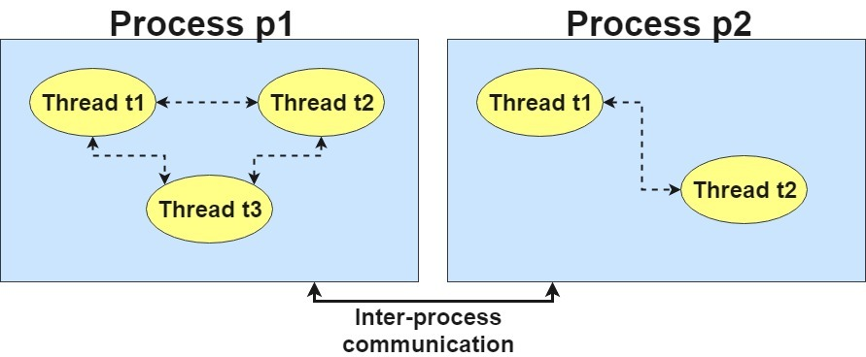
What is Thread in java?
A thread is a lightweight sub process, a smallest unit of processing.

Slide 190
Multithreading in Java Programming
Multithreading in java is a process of executing multiple threads simultaneously.
Multithreading is a Java feature that allows concurrent execution of two or more parts of a program for maximum utilization of CPU. Each part of such program is called a thread.
Thread is basically a lightweight sub-process, a smallest unit of processing.
Multiprocessing and multithreading, both are used to achieve multitasking. But we use multithreading than multiprocessing because threads share a common memory area. They don’t allocate separate memory area so saves memory, and context-switching between the threads takes less time than process.
Multitasking
Multitasking is a process of executing multiple tasks simultaneously. We use multitasking to utilize the CPU. Multitasking can be achieved by two ways:
Process-based Multitasking(Multiprocessing)
Thread-based Multitasking(Multithreading)
Advantages of Java Multithreading
It doesn’t block the user because threads are independent and you can perform multiple operations at same time.
You can perform many operations together so it saves time.
Threads are independent so it doesn’t affect other threads if exception occur in a single thread.

Slide 191
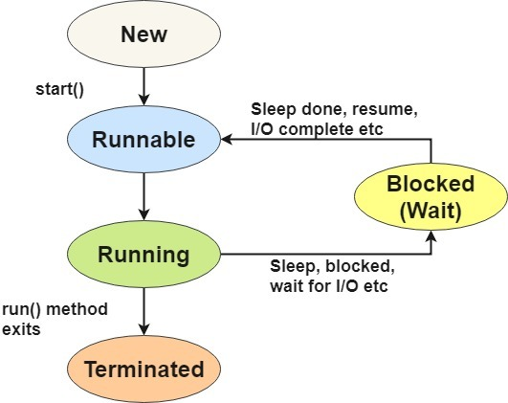
Life cycle of a Thread (Thread States)
A thread can be in one of the five states. The life cycle of the thread in java is controlled by JVM. The java thread states are as follows:
New
Runnable
Running
Non-Runnable (Blocked/Waiting)
Terminated

Slide 192
1) New
The thread is in new state if you create an instance of Thread class but before the invocation of start() method.
2) Runnable
The thread is in runnable state after invocation of start() method, but the thread scheduler has not selected it to be the running thread.
3) Running
The thread is in running state if the thread scheduler has selected it.
4) Non-Runnable (Blocked/Wait)
This is the state when the thread is still alive, but is currently not eligible to run.
5) Terminated
A thread is in terminated or dead state when its run() method exits.

Slide 193
Multithreading in Java by Inheriting Thread Class
Multithreading is a Java feature that allows concurrent execution of two or more parts of a program for maximum utilization of CPU. Each part of such program is called a thread. So, threads are light-weight processes within a process.
As discussed in the previous post Threads can be created by using two mechanisms :
1. Extending the Thread class
2. Implementing the Runnable Interface
class MultithreadingDemo extends Thread
{
public void run()
{
try
{
for(int i=0;i<5;i++){
// Displaying the thread that is running
System.out.println ("Thread " +
Thread.currentThread().getId() +
" is running");
}
}
catch (Exception e)
{
// Throwing an exception
System.out.println ("Exception is caught");
}
}
}
public class JavaApplication4 {
public static void main(String[] args) {
MultithreadingDemo object = new MultithreadingDemo();
object.start();
for(int i=0;i<5;i++){
// Displaying the thread that is running
System.out.println ("main Thread " +
Thread.currentThread().getId() +
" is running");
}
}
}
Output –
main Thread 1 is running
main Thread 1 is running
main Thread 1 is running
Thread 10 is running
main Thread 1 is running
Thread 10 is running
main Thread 1 is running
Thread 10 is running
Thread 10 is running
Thread 10 is running

Slide 194
Thread Class vs Runnable Interface
If we extend the Thread class, our class cannot extend any other class because Java doesn’t support multiple inheritance. But, if we implement the Runnable interface, our class can still extend other base classes.
We can achieve basic functionality of a thread by extending Thread class because it provides some inbuilt methods like yield(), interrupt() etc. that are not available in Runnable interface.
Multithreading in Java by Implementing Runnable Interface
class MultiThread implements Runnable {
@Override
public void run() {
for (int i = 0; i < 10; i++) {
System.out.println("Thread " + Thread.currentThread().getId()+ " is running");
}
}
}
public class JavaApplication4 {
public static void main(String[] args) {
Thread object = new Thread(new MultiThread());
object.start();
for (int i = 0; i < 10; i++) {
System.out.println("Main Thread id: " + Thread.currentThread().getId());
}
}
}
Output –
Main Thread id: 1
Thread 10 is running
Main Thread id: 1
Main Thread id: 1
Main Thread id: 1
Thread 10 is running
Thread 10 is running
Thread 10 is running
Thread 10 is running
Main Thread id: 1
Thread 10 is running
Main Thread id: 1
Main Thread id: 1
Main Thread id: 1
Main Thread id: 1
Main Thread id: 1
Thread 10 is running
Thread 10 is running
Thread 10 is running
Thread 10 is running

Slide 195
Sleep method in java
The sleep() method of Thread class is used to sleep a thread for the specified amount of time.
Syntax of sleep() method in java
The Thread class provides two methods for sleeping a thread:
public static void sleep(long miliseconds)throws InterruptedException
public static void sleep(long miliseconds, int nanos)throws InterruptedException
Example of sleep method in java
class TestSleepMethod1 extends Thread{
public void run(){
for(int i=1;i<5;i++){
try{Thread.sleep(500);}catch(InterruptedException e){System.out.println(e);}
System.out.println(i);
}
}
public static void main(String args[]){
TestSleepMethod1 t1=new TestSleepMethod1();
t1.start();
}
}

Slide 196
Priority of a Thread (Thread Priority)
In a Multi threading environment, thread scheduler assigns processor to a thread based on priority of thread. Whenever we create a thread in Java, it always has some priority assigned to it. Priority can either be given by JVM while creating the thread or it can be given by programmer explicitly.
Accepted value of priority for a thread is in range of 1 to 10.
There are are 3 basic priority constants defined in the Thread Class –
public static int MIN_PRIORITY (1)
public static int NORM_PRIORITY (5)
public static int MAX_PRIORITY (10)
Default priority of a thread is 5 (NORM_PRIORITY). The value of MIN_PRIORITY is 1 and the value of MAX_PRIORITY is 10.

Slide 197
class TestMultiPriority1 extends Thread{
public void run(){
System.out.println("running thread name is:"+Thread.currentThread().getName());
System.out.println("running thread priority is:"+Thread.currentThread().getPriority());
}
public static void main(String args[]){
TestMultiPriority1 m1=new TestMultiPriority1();
TestMultiPriority1 m2=new TestMultiPriority1();
m1.setPriority(Thread.MIN_PRIORITY);
m2.setPriority(Thread.MAX_PRIORITY);
m1.start();
m2.start();
}
}
Output:running thread name is:Thread-0
running thread priority is:10
running thread name is:Thread-1
running thread priority is:1

Slide 198
Below is a table of differences between Git and GitHub:
S.No. | Git | GitHub
1. | Git is a software. | GitHub is a service.
2. | Git is a command-line tool | GitHub is a graphical user interface
3. | Git is installed locally on the system | GitHub is hosted on the web
4. | Git is maintained by linux. | GitHub is maintained by microsoft.
5. | Git is focused on version control and code sharing. | GitHub is focused on centralized source code hosting.
6. | Git is a version control system to manage source code history. | GitHub is a hosting service for Git repositories.
7. | Git was first released in 2005. | GitHub was launched in 2008.
8. | Git has no user management feature. | GitHub has built-in user management feature.

Slide 199
Servlets
Servlet technology is used to create a web application (resides at server side and generates a dynamic web page).
Servlet technology is robust and scalable because of java language. Before Servlet, CGI (Common Gateway Interface) scripting language was common as a server-side programming language. However, there were many disadvantages to this technology.
There are many interfaces and classes in the Servlet API such as Servlet, GenericServlet, HttpServlet, ServletRequest, ServletResponse, etc.

Slide 200
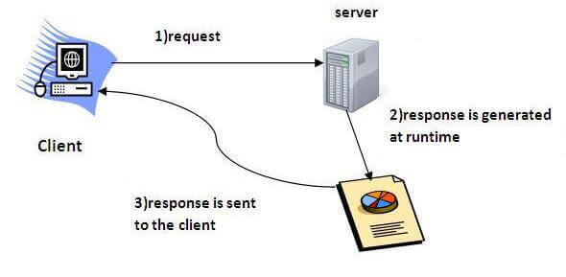
What is a Servlet?
Servlet is a technology which is used to create a web application.
Servlet is an API that provides many interfaces and classes including documentation.
Servlet is an interface that must be implemented for creating any Servlet.
Servlet is a class that extends the capabilities of the servers and responds to the incoming requests. It can respond to any requests.
Servlet is a web component that is deployed on the server to create a dynamic web page.

Slide 201
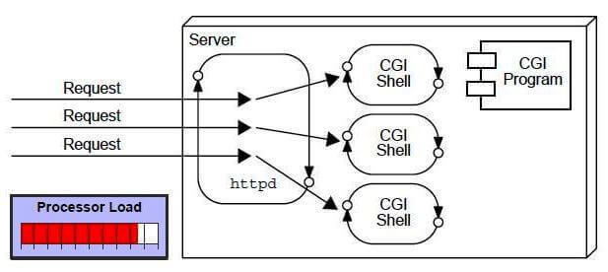
What is a web application?
A web application is an application accessible from the web. A web application is composed of web components like Servlet, JSP, Filter, etc. and other elements such as HTML, CSS, and JavaScript. The web components typically execute in Web Server and respond to the HTTP request.
CGI (Common Gateway Interface)
CGI technology enables the web server to call an external program and pass HTTP request information to the external program to process the request. For each request, it starts a new process.
Disadvantages of CGI
If the number of clients increases, it takes more time for sending the response.
For each request, it starts a process, and the web server is limited to start processes.
It uses platform dependent language e.g. C, C++, perl.

Slide 202
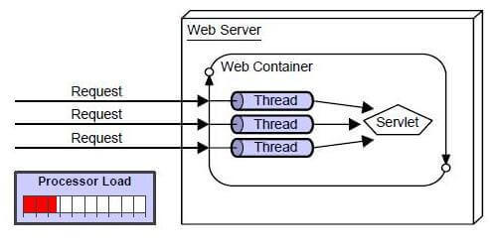
Advantages of Servlet
There are many advantages of Servlet over CGI.
The web container creates threads for handling the multiple requests to the Servlet.
Threads have many benefits over the Processes such as they share a common memory area, lightweight, cost of communication between the threads are low.
The advantages of Servlet are as follows:
Better performance: because it creates a thread for each request, not process.
Portability: because it uses Java language.
Robust: JVM manages Servlets, so we don't need to worry about the memory leak, garbage collection, etc.
Secure: because it uses java language.

Slide 203
Creating Servlet in myeclipse IDE
You need to follow the following steps to create the servlet in the myeclipse IDE. The steps are as follows:
Create a web project
create a html file
create a servlet
start myeclipse tomcat server and deploy project
1) Create the web project:
For creating a web project click on File Menu -> New -> web project -> write your project name e.g. first -> Finish.

Slide 204
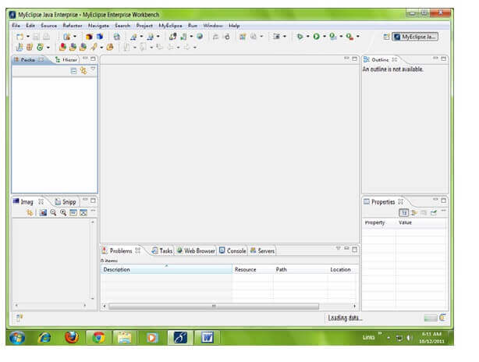

Slide 205
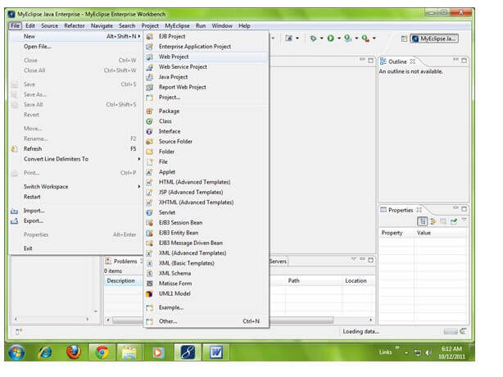

Slide 206
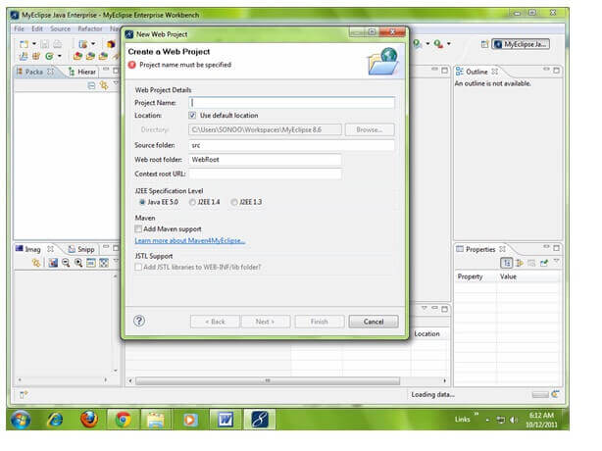

Slide 207
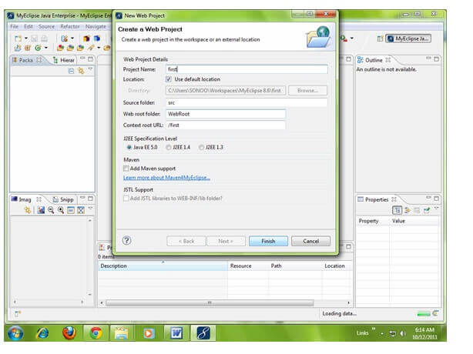

Slide 208
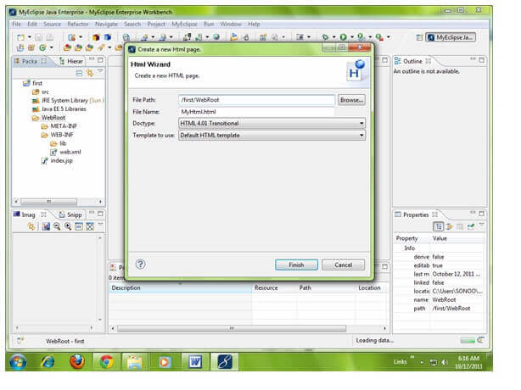
Create the html file:
As you can see that a project is created named first. Now let's explore this project.

Slide 209
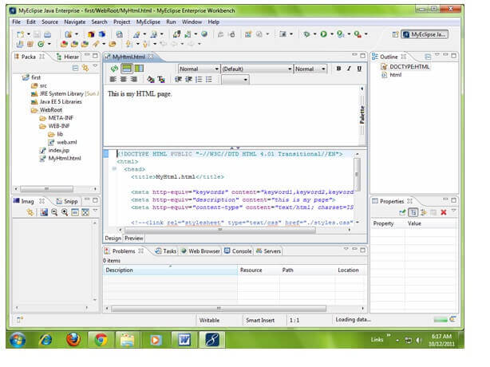

Slide 210
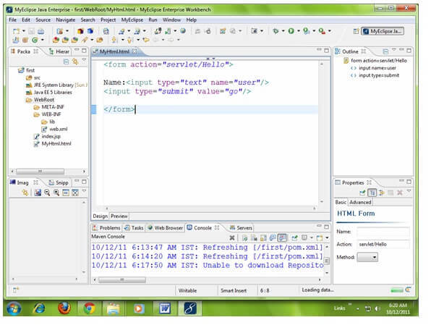

Slide 211
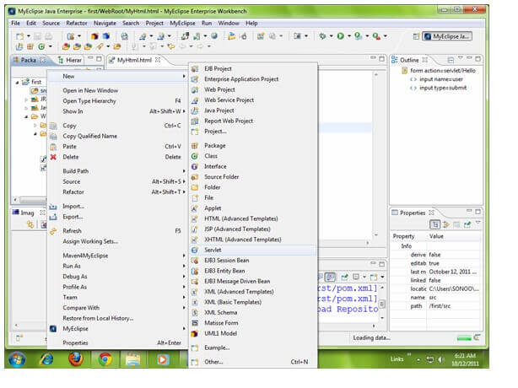
Create the servlet:
For creating a servlet click on File Menu -> New -> servlet -> write your servlet name e.g. Hello -> uncheck all the checkboxes except doGet() -> next -> Finish.

Slide 212
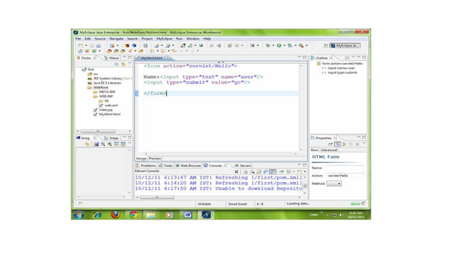

Slide 213
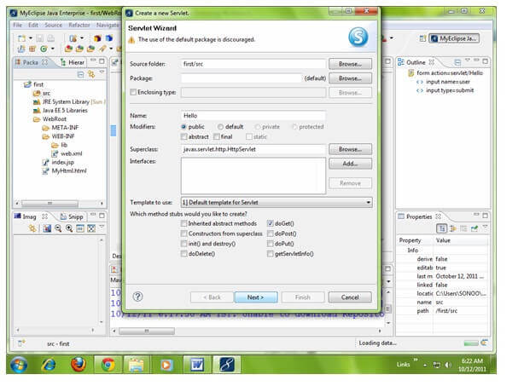

Slide 214
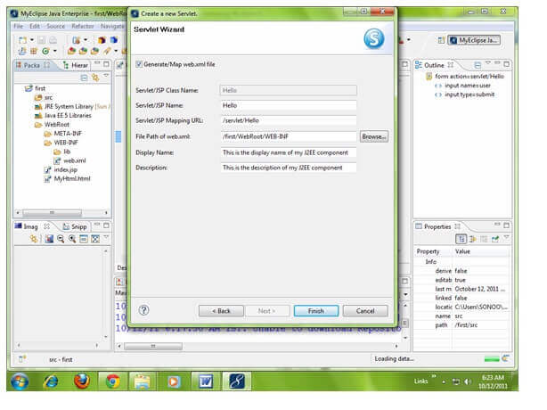

Slide 215
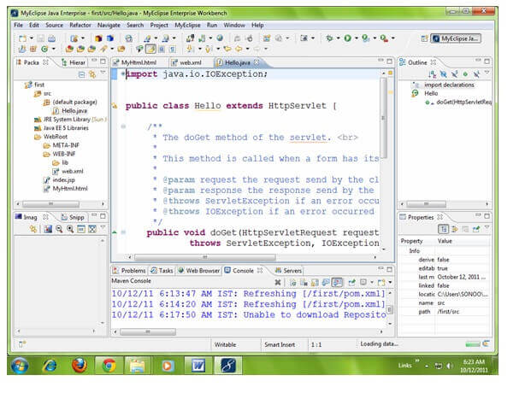

Slide 216
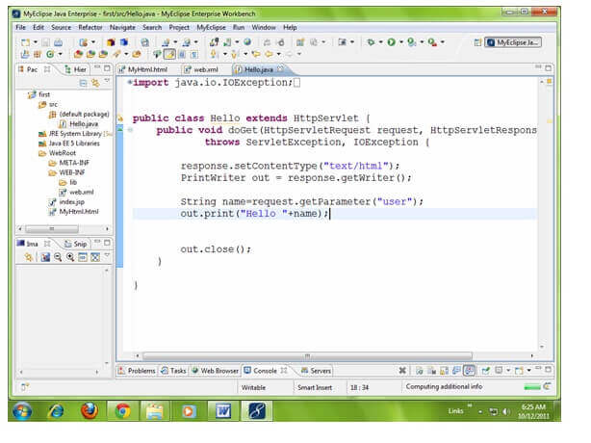

Slide 218
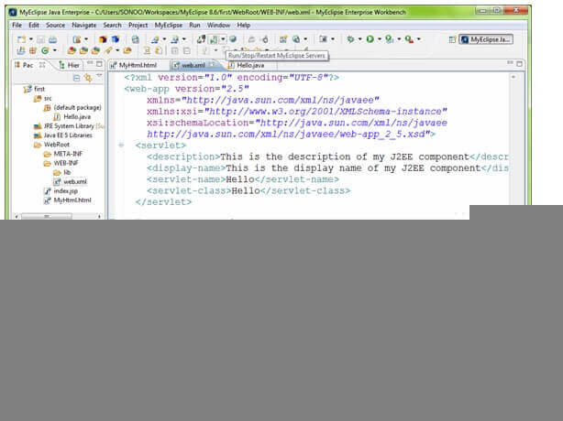
4) Start the server and deploy the project: For starting the server and deploying the project in one step Right click on your project -> Run As -> MyEclipse server application.

Slide 219
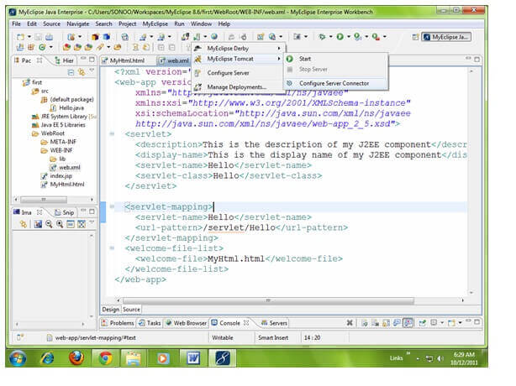

Slide 220
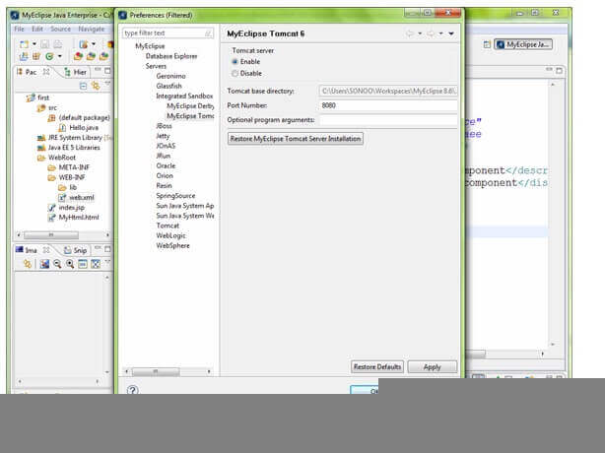

Slide 221
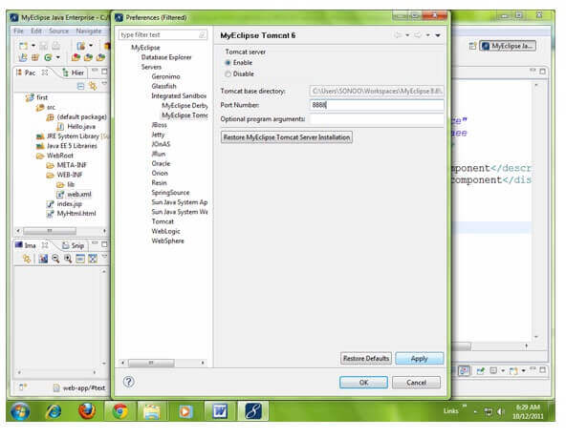

Slide 222
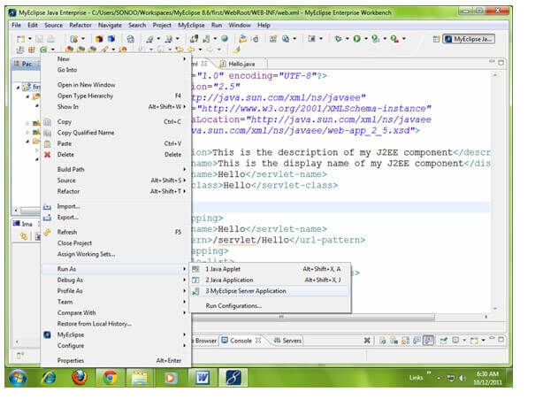

Slide 223
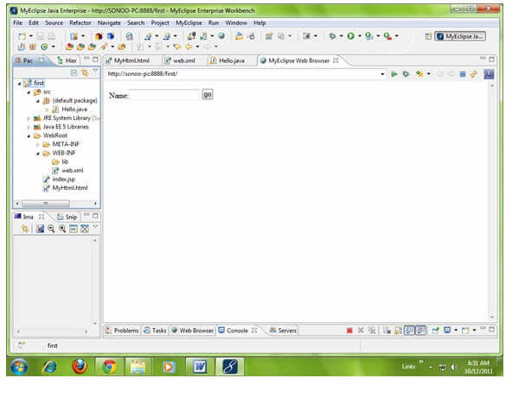

Slide 224
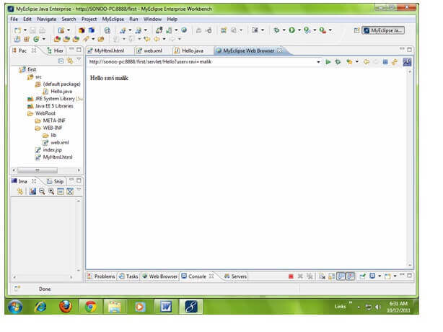

Slide 225
Servlet Terminology | Description
Website: static vs dynamic | It is a collection of related web pages that may contain text, images, audio and video.
HTTP | It is the data communication protocol used to establish communication between client and server.
HTTP Requests | It is the request send by the computer to a web server that contains all sorts of potentially interesting information.
Get vs Post | It gives the difference between GET and POST request.

Slide 226
Website
Website is a collection of related web pages that may contain text, images, audio and video.
The first page of a website is called home page.
Each website has specific internet address (URL) that you need to enter in your browser to access a website.
A website can be of two types:
Static Website
Dynamic Website

Slide 227
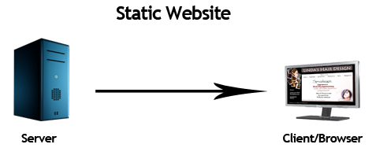
Static website
Static website is the basic type of website that is easy to create.
You don't need the knowledge of web programming and database design to create a static website.
Its web pages are coded in HTML.
The codes are fixed for each page so the information contained in the page does not change and it looks like a printed page.

Slide 228
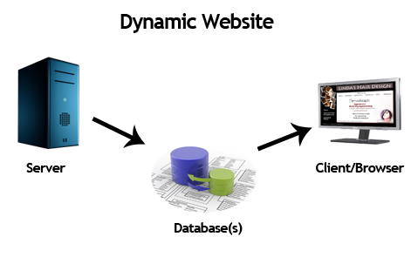
Dynamic website
Dynamic website is a collection of dynamic web pages whose content changes dynamically.
It accesses content from a database or Content Management System (CMS). Therefore, when you alter or update the content of the database, the content of the website is also altered or updated.

Slide 229
Static Website | Dynamic Website
Prebuilt content is same every time the page is loaded. | Content is generated quickly and changes regularly.
It uses the HTML code for developing a website. | It uses the server side languages such as PHP,SERVLET, JSP, and ASP.NET etc. for developing a website.
It sends exactly the same response for every request. | It may generate different HTML for each of the request.
The content is only changed when someone publishes and updates the file (sends it to the web server). | The page contains "server-side" code which allows the server to generate the unique content when the page is loaded.
Flexibility is the main advantage of static website. | Content Management System (CMS) is the main advantage of dynamic website.

Slide 230
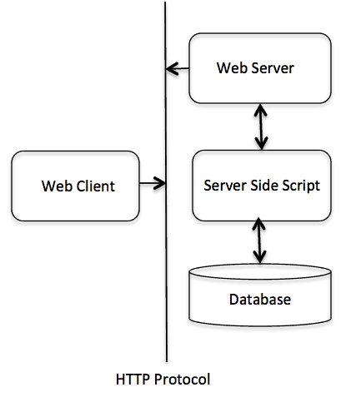
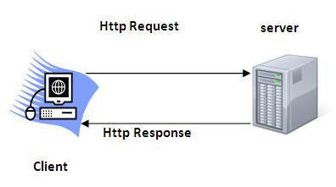
HTTP (Hyper Text Transfer Protocol)
It is the data communication protocol used to establish communication between client and server.
HTTP is TCP/IP based communication protocol, which is used to deliver the data like image files, query results, HTML files etc on the World Wide Web (WWW) with the default port is TCP 80.
It provides the standardized way for computers to communicate with each other.

Slide 231
HTTP Requests
The request sent by the computer to a web server, contains all sorts of potentially interesting information; it is known as HTTP requests.
The HTTP client sends the request to the server in the form of request message which includes following information:
The Request-line
The analysis of source IP address, proxy and port
The analysis of destination IP address, protocol, port and host
The Requested URI (Uniform Resource Identifier)
The Request method and Content
The User-Agent header
The Connection control header
The Cache control header

Slide 232
The HTTP request methods are:
HTTP Request | Description
GET | Asks to get the resource at the requested URL.
POST | Asks the server to accept the body info attached. It is like GET request with extra info sent with the request.
HEAD | Asks for only the header part of whatever a GET would return. Just like GET but with no body.
TRACE | Asks for the loopback of the request message, for testing or troubleshooting.
PUT | Says to put the enclosed info (the body) at the requested URL.
DELETE | Says to delete the resource at the requested URL.
OPTIONS | Asks for a list of the HTTP methods to which the thing at the request URL can respond

Slide 233
Get vs. Post
There are many differences between the Get and Post request. Let's see these differences:
GET | POST
1) In case of Get request, only limited amount of data can be sent because data is sent in header. | In case of post request, large amount of data can be sent because data is sent in body.
2) Get request is not secured because data is exposed in URL bar. | Post request is secured because data is not exposed in URL bar.
3) Get request can be bookmarked. | Post request cannot be bookmarked.
4) Get request is idempotent . It means second request will be ignored until response of first request is delivered | Post request is non-idempotent.

Slide 234

GET and POST
Two common methods for the request-response between a server and client are:
GET- It requests the data from a specified resource
POST- It submits the processed data to a specified resource
Anatomy of Get Request
The query string (name/value pairs) is sent inside the URL of a GET request:
GET/RegisterDao.jsp?name1=value1&name2=value2
As we know that data is sent in request header in case of get request. It is the default request type. Let's see what information is sent to the server.

Slide 235
Some other features of GET requests are:
It remains in the browser history
It can be bookmarked
It can be cached
It have length restrictions
It should never be used when dealing with sensitive data
It should only be used for retrieving the data

Slide 236

Anatomy of Post Request
The query string (name/value pairs) is sent in HTTP message body for a POST request:
POST/RegisterDao.jsp HTTP/1.1
Host: www. javatpoint.com
name1=value1&name2=value2
As we know, in case of post request original data is sent in message body. Let's see how information is passed to the server in case of post request.

Slide 237
JSP Elements
JSP Comments (Unexecutable Parts)
<% -- response.sendRedirect("http://studyeasy.org"); --%>
Expression Elements
<%= new java.util.Date() %>
<br/>
<%= 25*4 %>
<br/>
<%= 25>4 %>
Declarative Elements
<%!
String message(){
return "I love JSP";
}
%>
<%= message() %>
JSP
<%
for(int i=0;i<10;i++){
out.print("<br/>");
out.print(i);
}
%>

Slide 238
List of Content Types
There are many content types. The commonly used content types are given below:
text/html
text/plain
application/msword
application/vnd.ms-excel
application/jar
application/pdf
application/octet-stream
application/x-zip
images/jpeg
images/png
images/gif
audio/mp3
video/mp4
video/quicktime etc.

Slide 239
Servlet API
The javax.servlet and javax.servlet.http packages represent interfaces and classes for servlet api.
The javax.servlet package contains many interfaces and classes that are used by the servlet or web container. These are not specific to any protocol.
The javax.servlet.http package contains interfaces and classes that are responsible for http requests only.

Slide 240
Interfaces in javax.servlet package
There are many interfaces in javax.servlet package. They are as follows:
Servlet
ServletRequest
ServletResponse
RequestDispatcher
ServletConfig
ServletContext
SingleThreadModel
Filter
FilterConfig
FilterChain
ServletRequestListener
ServletRequestAttributeListener
ServletContextListener
ServletContextAttributeListener

Slide 241
Classes in javax.servlet package
There are many classes in javax.servlet package. They are as follows:
GenericServlet
ServletInputStream
ServletOutputStream
ServletRequestWrapper
ServletResponseWrapper
ServletRequestEvent
ServletContextEvent
ServletRequestAttributeEvent
ServletContextAttributeEvent
ServletException
UnavailableException

Slide 242
Interfaces in javax.servlet.http package
There are many interfaces in javax.servlet.http package. They are as follows:
HttpServletRequest
HttpServletResponse
HttpSession
HttpSessionListener
HttpSessionAttributeListener
HttpSessionBindingListener
HttpSessionActivationListener
HttpSessionContext (deprecated now)

Slide 243
Classes in javax.servlet.http package
There are many classes in javax.servlet.http package. They are as follows:
HttpServlet
Cookie
HttpServletRequestWrapper
HttpServletResponseWrapper
HttpSessionEvent
HttpSessionBindingEvent
HttpUtils (deprecated now)

Slide 244
Servlet Interface
Servlet interface provides common behavior to all the servlets.
Servlet interface defines methods that all servlets must implement.
Servlet interface needs to be implemented for creating any servlet (either directly or indirectly). It provides 3 life cycle methods that are used to initialize the servlet, to service the requests, and to destroy the servlet and 2 non-life cycle methods.
Methods of Servlet interface
There are 5 methods in Servlet interface. The init, service and destroy are the life cycle methods of servlet. These are invoked by the web container.
Method | Description
public void init(ServletConfig config) | initializes the servlet. It is the life cycle method of servlet and invoked by the web container only once.
public void service(ServletRequest request,ServletResponse response) | provides response for the incoming request. It is invoked at each request by the web container.
public void destroy() | is invoked only once and indicates that servlet is being destroyed.
public ServletConfig getServletConfig() | returns the object of ServletConfig.
public String getServletInfo() | returns information about servlet such as writer, copyright, version etc.

Slide 245
import java.io.*;
import javax.servlet.*;
public class First implements Servlet{
ServletConfig config=null;
public void init(ServletConfig config){
this.config=config;
System.out.println("servlet is initialized");
}
public void service(ServletRequest req,ServletResponse res)
throws IOException,ServletException{
res.setContentType("text/html");
PrintWriter out=res.getWriter();
out.print("<html><body>");
out.print("<b>hello simple servlet</b>");
out.print("</body></html>");
}
public void destroy(){System.out.println("servlet is destroyed");}
public ServletConfig getServletConfig(){return config;}
public String getServletInfo(){return "copyright 2007-1010";}
}

Slide 246

Life Cycle of a Servlet (Servlet Life Cycle)
The web container maintains the life cycle of a servlet instance. Let's see the life cycle of the servlet:
Servlet class is loaded.
Servlet instance is created.
init method is invoked.
service method is invoked.
destroy method is invoked.

Slide 247
1) Servlet class is loaded
The classloader is responsible to load the servlet class. The servlet class is loaded when the first request for the servlet is received by the web container.
2) Servlet instance is created
The web container creates the instance of a servlet after loading the servlet class. The servlet instance is created only once in the servlet life cycle.
3) init method is invoked
The web container calls the init method only once after creating the servlet instance. The init method is used to initialize the servlet. It is the life cycle method of the javax.servlet.Servlet interface. Syntax of the init method is given below:
public void init(ServletConfig config) throws ServletException {
// Initialization code...
}

Slide 248
The service() Method
The service() method is the main method to perform the actual task. The servlet container (i.e. web server) calls the service() method to handle requests coming from the client( browsers) and to write the formatted response back to the client.
Each time the server receives a request for a servlet, the server spawns a new thread and calls service. The service() method checks the HTTP request type (GET, POST, PUT, DELETE, etc.) and calls doGet, doPost, doPut, doDelete, etc. methods as appropriate.
Here is the signature of this method −
public void service(ServletRequest request, ServletResponse response)
throws ServletException, IOException {
}
The service () method is called by the container and service method invokes doGet, doPost, doPut, doDelete, etc. methods as appropriate. So you have nothing to do with service() method but you override either doGet() or doPost() depending on what type of request you receive from the client.
The doGet() and doPost() are most frequently used methods with in each service request. Here is the signature of these two methods.

Slide 249
The doGet() Method
A GET request results from a normal request for a URL or from an HTML form that has no METHOD specified and it should be handled by doGet() method.
public void doGet(HttpServletRequest request, HttpServletResponse response)
throws ServletException, IOException {
// Servlet code
}
The doPost() Method
A POST request results from an HTML form that specifically lists POST as the METHOD and it should be handled by doPost() method.
public void doPost(HttpServletRequest request, HttpServletResponse response)
throws ServletException, IOException {
// Servlet code
}
The destroy() Method
The destroy() method is called only once at the end of the life cycle of a servlet. This method gives your servlet a chance to close database connections, halt background threads, write cookie lists or hit counts to disk, and perform other such cleanup activities.
After the destroy() method is called, the servlet object is marked for garbage collection. The destroy method definition looks like this −
public void destroy() {
// Finalization code...
}

Slide 250

Architecture Diagram
The following figure depicts a typical servlet life-cycle scenario.
First the HTTP requests coming to the server are delegated to the servlet container.
The servlet container loads the servlet before invoking the service() method.
Then the servlet container handles multiple requests by spawning multiple threads, each thread executing the service() method of a single instance of the servlet.

Slide 251
Agenda -20/5/2021
1 Jsp form design
2 servelets form design
3 jsp servelets form design with validation
4 jsp elements ( expression , scriplets , comments, declaration , derective )
5 include files into jsp file
6 import clases into jsp file
7 get and post method
Forward and redirect
(M)VC
Java Beans scope

Slide 252
Agenda -5/5/2021
1forwarding and Redirecting the pages under JSP
2MVC architecture and simple example
3 form Elements
4 Form Design by using JSP
5 Form Design by using Servelts contraoller
6 Form Validation

Slide 253
Agenda -6/5/2021
1 Encapsulation – setters and getters
2 java beans – Different scope (session , application , page , request)
3 beans with webforms

Slide 254
JSTL Core Tags
The JSTL core tag provides variable support, URL management, flow control etc. The syntax used for including JSTL core library in your JSP is:
<%@ taglib uri="http://java.sun.com/jsp/jstl/core" prefix="c" %>
Tags Description
c:out It display the result of an expression, similar to the way <%=...%> tag work.
c:import It Retrives relative or an absolute URL and display the contents to either a String in 'var',a Reader in 'varReader' or the page.
c:set It sets the result of an expression under evaluation in a 'scope' variable.
c:remove It is used for removing the specified scoped variable from a particular scope.
c:catch It is used for Catches any Throwable exceptions that occurs in the body.
c:if It is conditional tag used for testing the condition and display the body content only if the expression evaluates is true.
c:choose, c:when, c:otherwise It is the simple conditional tag that includes its body content if the evaluated condition is true.
c:forEach It is the basic iteration tag. It repeats the nested body content for fixed number of times or over collection.
c:forTokens It iterates over tokens which is separated by the supplied delimeters.
c:param It adds a parameter in a containing 'import' tag's URL.
c:redirect It redirects the browser to a new URL and supports the context-relative URLs.
c:url It creates a URL with optional query parameters.

Slide 255
JSTL Function Tags
The JSTL function provides a number of standard functions, most of these functions are common string manipulation functions. The syntax used for including JSTL function library in your JSP is:
<%@ taglib uri="http://java.sun.com/jsp/jstl/functions" prefix="fn" %>
JSTL Functions Description
fn:contains() It is used to test if an input string containing the specified substring in a program.
fn:containsIgnoreCase() It is used to test if an input string contains the specified substring as a case insensitive way.
fn:endsWith() It is used to test if an input string ends with the specified suffix.
fn:escapeXml() It escapes the characters that would be interpreted as XML markup.
fn:indexOf() It returns an index within a string of first occurrence of a specified substring.
fn:trim() It removes the blank spaces from both the ends of a string.
fn:startsWith() It is used for checking whether the given string is started with a particular string value.
fn:split() It splits the string into an array of substrings.
fn:toLowerCase() It converts all the characters of a string to lower case.
fn:toUpperCase() It converts all the characters of a string to upper case.
fn:substring() It returns the subset of a string according to the given start and end position.
fn:substringAfter() It returns the subset of string after a specific substring.
fn:substringBefore() It returns the subset of string before a specific substring.
fn:length() It returns the number of characters inside a string, or the number of items in a collection.
fn:replace() It replaces all the occurrence of a string with another string sequence.

Slide 256
JSTL Formatting tags
The formatting tags provide support for message formatting, number and date formatting etc. The url for the formatting tags is http://java.sun.com/jsp/jstl/fmt and prefix is fmt.
The JSTL formatting tags are used for internationalized web sites to display and format text, the time, the date and numbers. The syntax used for including JSTL formatting library in your JSP is:
<%@ taglib uri="http://java.sun.com/jsp/jstl/fmt" prefix="fmt" %>
fmt:parseNumber It is used to Parses the string representation of a currency, percentage or number.
fmt:timeZone It specifies a parsing action nested in its body or the time zone for any time formatting.
fmt:formatNumber It is used to format the numerical value with specific format or precision.
fmt:parseDate It parses the string representation of a time and date.
fmt:bundle It is used for creating the ResourceBundle objects which will be used by their tag body.
fmt:setTimeZone It stores the time zone inside a time zone configuration variable.
fmt:setBundle It loads the resource bundle and stores it in a bundle configuration variable or the named scoped variable.
fmt:message It display an internationalized message.
fmt:formatDate It formats the time and/or date using the supplied pattern and styles.

Slide 257
JSTL SQL Tags
The JSTL sql tags provide SQL support. The url for the sql tags is http://java.sun.com/jsp/jstl/sql and prefix is sql.
The SQL tag library allows the tag to interact with RDBMSs (Relational Databases) such as Microsoft SQL Server, mySQL, or Oracle. The syntax used for including JSTL SQL tags library in your JSP is:
<%@ taglib uri="http://java.sun.com/jsp/jstl/sql" prefix="sql" %>
sql:setDataSource It is used for creating a simple data source suitable only for prototyping.
sql:query It is used for executing the SQL query defined in its sql attribute or the body.
sql:update It is used for executing the SQL update defined in its sql attribute or in the tag body.
sql:param It is used for sets the parameter in an SQL statement to the specified value.
sql:dateParam It is used for sets the parameter in an SQL statement to a specified java.util.Date value.
sql:transaction It is used to provide the nested database action with a common connection.

